Slide 1
ᏣᎳᎩ 101
Introduction to Cherokee Language
ᏗᏕᏲᎲᏍᎩ ᏚᏯ
Dr. Ben Frey

Slide 2
Housekeeping
Syllabus – hard copy now, digital available on Sakai
Sakai – course website at https://sakai.unc.edu/portal/site/cherokee101fall2016
Homework and other resources will be posted on Sakai.
Office hours: MW 11-12 & by appointment
Email: benfrey@email.unc.edu

Slide 3
Who am I?
Dr. Ben Frey, UNC American Studies
Citizen of the EBCI
2nd Language learner of Cherokee since ca. 2003 (started at age 20).
Began via a grammar book by my great uncle
Moved into Master/Apprentice program w/ Tom Belt
Worked with New Kituwah Academy since 2005.

Slide 4
Who are you?
Please give your name
Where you’re from
What you’d like to get out of this course
What motivated you to learn Cherokee

Slide 5
Why are we here?
Cherokee in NC – 13,000 year tradition
Currently ~ 200-250 speakers (+ ~6,000 in OK)
Cherokee thought, knowledge, culture
Ꮟ ᎣᏤᏙᎭ! – We are still here!
  Immersion school
  WCU’s Cherokee language program
  Speakers’ gatherings on Qualla Boundary
  …and you.

Slide 6
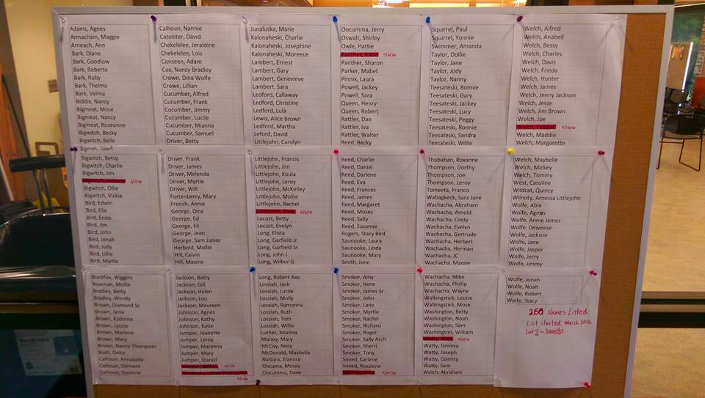
“The List”

Slide 7
So what are we doing?
We are here to speak, hear, read, and write the Cherokee language - ᏣᎳᎩ ᎦᏬᏂᎯᏍᏗ.
Have you all come here to learn this?
  I ask because you don’t have to be here.
  I am supposed to help you.
  My name is not on that list – I am not perfect, and you don’t have to be either.

Slide 8
What if something happens?
We all end up undergoing problems – big & small.
It is NORMAL for life to throw you curveballs.
If something happens – be it anxiety, depression, death, sickness, family crisis…whatever – let me know something is going on so we can work together to get you through.
If I don’t know, and you just don’t show up to class or complete assignments, I can’t help you.

Slide 9
How to learn
LISTEN – inside & outside of class. Focus more on listening and interacting than writing.
SPEAK – language involves MUSCLES – it’s like a musical instrument.
PRACTICE – role-play with each other. Be a shopkeeper and a customer. What would you say? Practice!
Learn to love your mistakes. They are opportunities to learn.
Work together – you are each other’s best resources. Get each other’s contact information & plan to study together.

Slide 10
What will happen?
We learn by immersion to the degree possible.
Expect the “Wall of Noise.”
It’s all about CONTEXT. What is someone likely to say to you when you first meet them? What about at a restaurant? At the counter to buy movie tickets? Use your intuition!
Fear – and what to do with it (make it your friend.)

Slide 11
What will we learn?
Greetings and introductions
Discussion of self and others
Describing things in the world around us
Taking actions
Reading & Writing in Sequoyan Syllabary (quizzes on Fridays)

Slide 12
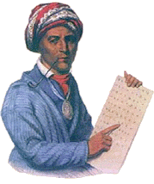
Sequoyah

Slide 13
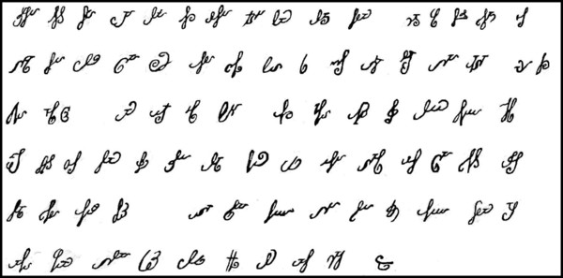
Sequoyah’s original syllabary

Slide 14
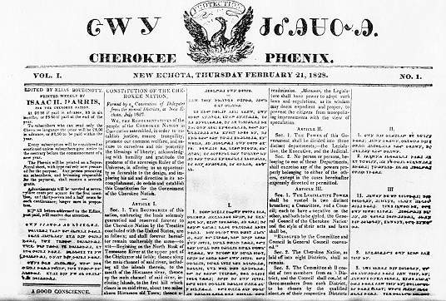
First American Indian language newspaper

Slide 15

Printed Syllabary
(note on spelling)

Slide 16
Intro to Cherokee Sounds
Vowels – a, e, i, o, u, v
  Kvna
  V:li
  Gesv:’i
Consonants –
  g, k, h, l, m, n, kw, s, d, t, hl, ts, w, y, ‘

Slide 17
Sounds Practice - h
“ahnawo”
“wahya”
“gahlkwogi”
“gihli”

Slide 18
Sounds Practice – ‘
‘ – a “glottal stop” between vowels
na’v
a:’i
gego:’i
hegv:’i

Slide 19
Sounds Practice - ts
tsalagi
o:tsaduli
tsgoyi
tsine:la

Slide 20
Sounds practice - length
Ama a:ma
Eha e:ha
Agiyelaha agiyelahv:
Wasagi’a wasagi:’a

Slide 21
Homework
Homework is listed on Sakai site
Remember to practice your syllabary characters!
Quiz on row 1 is this Friday.
We will begin class in Cherokee on Friday.

