Slide 1
ᏣᎳᎩ 101
Introductions and Expanding Greetings

Slide 2
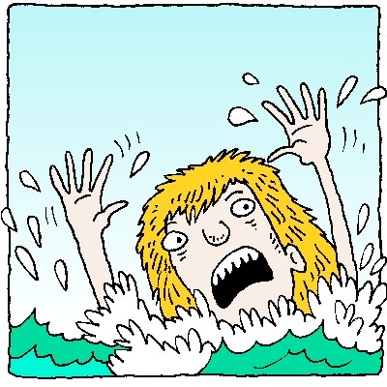
ᏍᎩᏍᏕᎳ:
Rescue Phrases!
Sgisdela!
  Help me!
Usganolige hniwi
  say it slower
Sigwu hniwi
  say it again
Gedo iyusdi tsanadisgo:’i
  How do they say

Slide 3

ᏍᎩᏍᏕᎳ:
Rescue Phrases
Tsalagi gvhdi
  In Cherokee
Gedo iyusdi gadvgv’i…
  What is the meaning of...
Gedo iyusdi hi’a?
  What is this?
Gesdi yitsigata!
  I don’t know!
Gesdi yigoliga!
  I don’t understand!

Slide 4
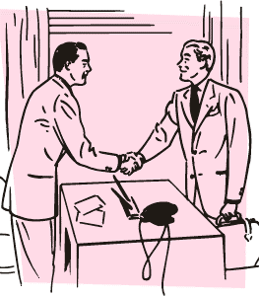
Greetings!
Osigwotsu? … “_____” ?
Tohigwotsu? ... “____”?
Hayolidatsu? ... “____” ?
Osigwuke tsadanati?... “____” ?
“dogwu tsadanati?” … “osda / gali’eliga / uyo agwadanati...”

Slide 5

Ditsadahlinohehla!
Pick 1 to ask & answer! (5 ᎠᏂᏴᏫ)
“Siyo!”
“Osigwotsu?”
“tohigwotsu?”
“tohigwuke tsadanati?”
“hayolidatsu?”

Slide 6
ᏗᏥᎦᏙᏍᏓ!
nige
(h)edoha
oginali’i
____ dudo’a
____ dagwado’a
digwenvsv’i dagesi
gali’eliga tsidenadolvgi!
https://youtu.be/u2BZif72d8g

Slide 7
“digwenvsv dagesi”

Slide 8
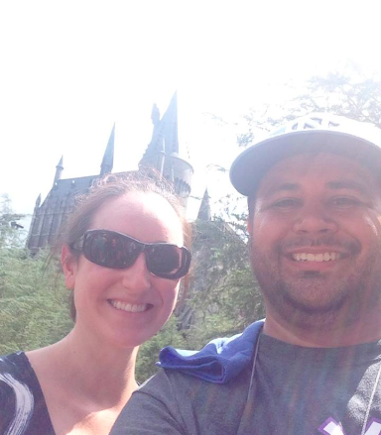
oginali’i
Hi’a oginali’i! Jennifer dudo’a.

Slide 9
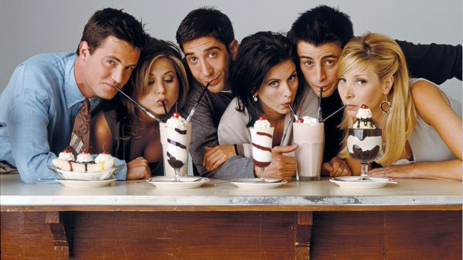
unali’i – gedo iyusdi dunado’a?

Slide 10
“osda denadolvgv’i!”

Slide 11
Siyo! Justin dagwado’a!

Slide 12
Gedo iyusdi dudo’a?

Slide 13
Gedo iyusdi dagwado’a?

Slide 14
Gedo iyusdi detsado’a?

Slide 15
Ditsalehvga!
(4x – 4 aniyvwi)
A: “Siyo! Osigwotsu?”
B: “Osigwu, nihina?”
A: “Osda, sgi! ________ dagwado’a. Gedo detsado’a?”
B: “______ dagwado’a. Gali’eliga tsidenadolvgi!”
A: “Ayvsgwu gali’eliga tsidenadolvgi.”
B: “hawa! Denadagohv’i!”
A: “Denadagohv’i.”

Slide 16
Adelahohisdodi!
“osigwotsu?”
“tohigwotsu?”
“osigwuke tsadanti?”
“osigwusgo?

Slide 17
Adelahohisdodi!
-tsu
-ke
-sgo

Slide 18
Hi’a digohwelododi!

Slide 19
Digohwelododitsu? vv...digohwelododi.

Slide 20
Hi’a dagwalela!

Slide 21
Dagwalelasgo?
Hadi…hi’a atsadi.

Slide 22
Gedo iyusdi hi’a? dagwalelake?

Slide 23
Osda nitsadvga!
Tso’ine iga dedadagohvyu!

