Slide 1
ᏣᎳᎩ 101
Names Practice & “Where do you live?”

Slide 2
°ᏙᏪᎳᎦ!
Tohwelaga!
Which greetings go with which answers?

Slide 3
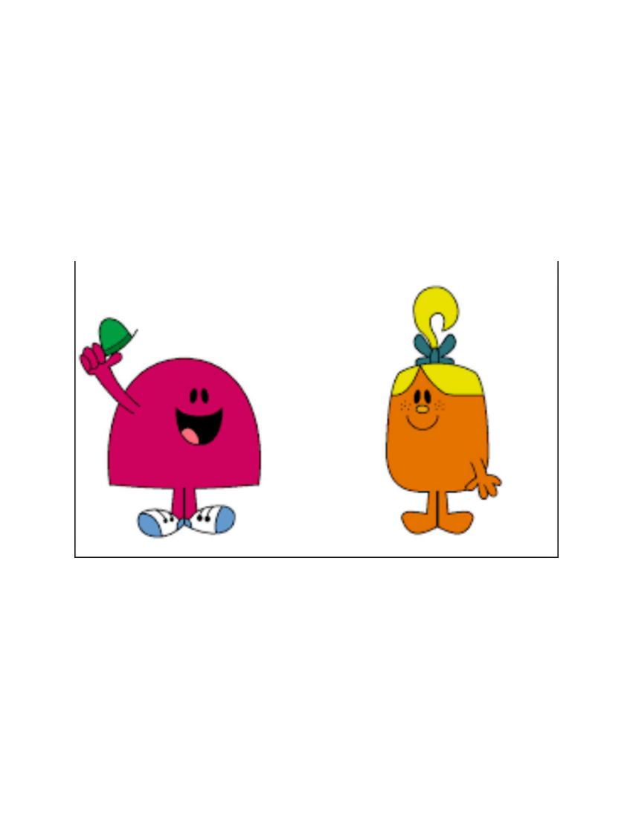
ᏗᏣᎴᎲᎦ!
Ditsalehvga!
5 iyuwakti “siyo” nitsiwi, nole...
  hayolidatsu
  osigwotsu
  tohigwotsu
  osigwuke tsadanti
Ditsitadvhvga.

Slide 4
ᎧᎩ ᎢᏳᏍᏗ ᎯᎠ?
Kagi iyusdi hi’a?
ᎨᏙ ᎢᏳᏍᏗ ᏚᏙᎠ…? Gedo iyusdi dudo’a...?
  (ᎨᏙ ᎢᏳᏍᏗ ᏕᏣᏙᎠ?) - (gedo iyusdi detsado’a?)
  (If you don’t know someone’s name...maybe ^ ask them!)

Slide 5
“ᎦᏨ ᎯᏁᎳ?” gatsv hinela?
A: ”gatsv hinela?”
B: “Vintage Drive tsinela – egwa kaltsode. Nihina?”
A: “Ehringhaus adanelv tsinela. Udohiyu egwa adanelv!”

Slide 6
Egwa? Ale usdi?
Egwa adanelv
Usdi adanelv

Slide 7
Egwa? Ale usdi?
Egwa kaltsode
Usdi kaltsode

Slide 8
Egwa? Ale usdi?
Egwa gihli!
Usdi gihli!

Slide 9
Egwa? Ale usdi?

Slide 10
Adanelv? Ale kalitsode?
adanelv
adanelv

Slide 11
Adanelv? Ale kalitsode?
kalitsode
kalitsode

Slide 12
Adanelv? Ale kalitsode?

Slide 13
ᎢᏣᏓᏔᏛᎲᎦ!
Itsadatadvhvga! 5x aniyvwi!
A: “gatsv hinela?”
B: ______ tsinela
A: “egwasgo ale usdi?”
B: (egwa / usdi) (kaltsode / adanelv) tsinela – nihina?
A: _______

Slide 14
Digohweli aksesdodi!
Osda nigalisdihesdi utugi gvhdi!

