Slide 1
ᏣᎳᎩ 101
Intro Clothes & Colors

Slide 2
ᏗᏣᎴᎲᎦ!
5 ᎢᏯᏂ ᎠᏂᏴᏫ ᏗᏣ°ᏛᏛᎲᎦ…
“Gedo iyusdi tsadvneti tsalvkwodi?” (use worksheet)
“Egwasg ale usdi detsadatina’v’i? hvga iyani aniyvwi?”
“Gatsv tsadene’i?”

Slide 3
Ask…and answer
“gatsv ganela tsatsi?” “Alabama ___-nela ____-tsi”
“hvga iyani aniyvwi detsadatina’v’i?” “6 iyani aniyvwi d___datina’v’i”
“kagohno tsadoda?” “Charlie d__do’a ___doda”
“Gedo iyusdi dudo’a sdatlinvtsi?” “Brad d_do’a ___tlinvtsi.”
“Tsayosihatsu?” “vv, ___yosiha!”
“sdatadegi’asg? Nihi nole Aaron?” “vv, ___tadegi’a!” (Set B)
“Pride and Prejudice’isg itsigoliyesge’i?” “vv, ____goliyesgv’i.”

Slide 4
ᎤᎸᏉᏗᏍᎪ? ᎠᎴ ᎨᏍᏗ ᏳᎸᏉᏗ?
Ulvkwodisg? Ale gesdi yulvkwodi?

Slide 5
ᏣᎸᏉᏗᏍᎪ?
“vv! unvdi agilvkwodi!” / “hadi! Gesdi yagilvkwodi unvdi.”
“unvdisg tsalvkwodi?”
3 iyani aniyvwi itsitvdvhvga!

Slide 6

ᎢᎾᎨ ᎠᏁᎯ ᏧᎾᎳᏑᏫᏓ

Slide 7

ᎩᎦᎨᎢ

Slide 8

ᎠᏓᎶᏂᎨᎢ

Slide 9

ᏓᎶᏂᎨᎢ

Slide 10

ᎠᏤᎢ

Slide 11

Ꮜ°ᎪᏂᎨᎢ

Slide 12

ᎤᏪᏘᎨᎢ / ᏕᎷᎨᎢ

Slide 13

ᏓᎶᏂᎨᎢ ᏃᎴ ᎠᏓᎶᏂᎨᎢ

Slide 14

ᎠᏓᎶᏂᎨᎢ ᏃᎴ ᎩᎦᎨᎢ

Slide 15

ᎩᎦᎨᎢ ᏃᎴ Ꮜ°ᎪᏂᎨᎢ

Slide 16

Ꮜ°ᎪᏂᎨᎢ ᏃᎴ ᎠᏤᎢ

Slide 17
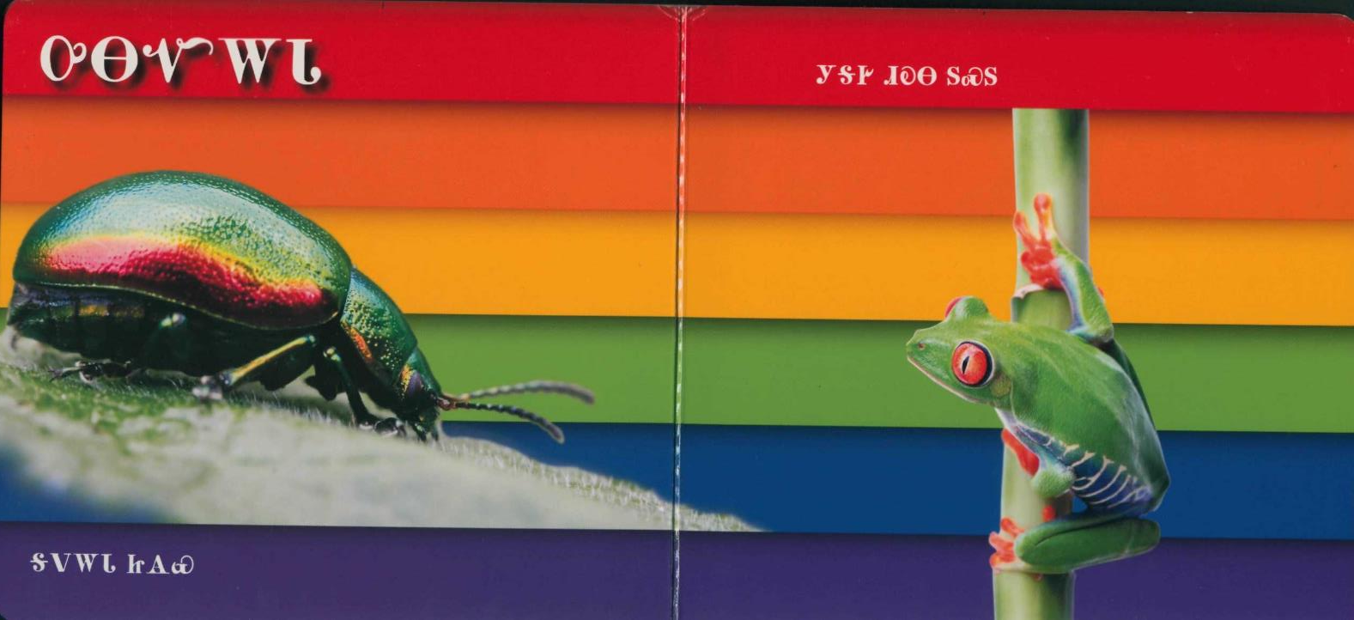
ᎤᎾᏉᎳᏓ

Slide 18
ᎤᏬᏗᎨᎢ uwodige’i

Slide 19
ᎤᏁᎦ unega

Slide 20
ᎬᎿᎨᎢ gvhnage’i

Slide 21
ᎬᎿᎨᎢ ᎤᏍᎪᎸᎢ gvhnage’i usgolv’i

Slide 22
ᎩᎦᎨᎢ ᎤᏍᎪᎸᎢ gigage’i usgolv’i

Slide 23
ᎤᏍᎪᎸ ᎠᎴ ᎤᏍᎪᏍᏗ?
Usgolv ale usgosdi?
Sakonige usgolv
Sakonige usgosdi / kali sakonige

Slide 24
5 ᎢᏯᏂ ᎠᏂᏴᏫ ᏗᏥ°ᏛᏛᎲᎦ!
“gedo iyusdi alsuwida tsalvkwodi?”
“_____ agilvkwodi! Nihina?”

