Slide 1
ᏣᎳᎩ 101
Clothing, Months, Days of the week

Slide 2
ᏏᏲ! ᏂᎦᏓ ᏗᏣᎴᎲᎦ ᏃᎴ ᏗᏣᏓᏲᎵᎳ!
“ᏏᏲ! ᎣᏏᏉᏧ?”
ᏣᎸᏉᏗᏍᎪ… (ᎠᏆᎿᏬ? ᏗᏆᎳᏑᎶ? ᎠᏆᏑᎶ?)
  ᎥᎥ! ᎤᏬᏚᎯ
  ᎭᏗ! ᎨᏍᏗ ᏯᎩᎸᏉᏗ.
ᎨᏙ ᎢᏳᏍᏗ ᎠᎳᏑᏫᏓ ᏣᎸᏉᏗ?

Slide 3
ᎨᏙ ᎢᏳᏍᏗ ᎤᎳᏍᏇᏔᏩ?
“ᎡᏆ ᎤᏬᏗᎨ ᎠᎳᏍᏇᏔᏬ ᎤᎳᏍᏇᏔᏩ.”

Slide 4
ᎨᏙ ᎢᏳᏍᏗ ᎤᎳᏍᏇᏔᏩ?
“ᎤᏍᏗ ᎤᏁᎦ ᎠᎳᏍᏇᏔᏬ ᎤᎳᏍᏇᏔᏩ.”

Slide 5
ᎨᏙ ᎢᏳᏍᏗ ᎤᏑᏝ? “…ᎤᏑᏝ.”

Slide 6
ᎨᏙ ᎢᏳᏍᏗ ᎤᏂᏩ?

Slide 7
ᎨᏙ ᎢᏳᏍᏗ ᏧᏂᎾᏩ?

Slide 8
ᎨᏙ ᎢᏳᏍᏗ ᏚᏂᎵᏲ?

Slide 9
ᎨᏙ ᎢᏳᏍᏗ ᏧᏂᎳᏑᏝ?

Slide 10
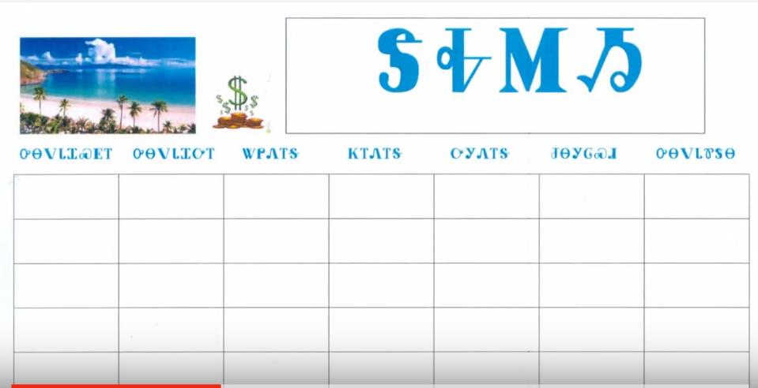
ᏅᏙ ᏗᏎᏍᏗ
https://youtu.be/WahfKQ0kKIY

Slide 11
ᎲᎦ ᏣᏕᏘᏴᏓ?
ᎲᎦ ᏣᏕᏘᏴᏓ?
33 ᎠᏆᏕᏘᏴᏓ.
5 ᎢᏯᏂ ᎠᏂᏴᏫ ᏗᏥ°ᏛᏛᎲᎦ - “ᎲᎦ ᏣᏕᏘᏴᏓ?”

Slide 12
ᎯᎳᎢᏳ ᏣᏘᏱᏍᎬ?
ᎨᏙ ᎤᏍᏗ ᏏᏅᏙ ᏣᏕᏘᏱᏍᎬ?
15^{ᏏᏁ} ᎫᏰᏉᏂ ᎠᏆᏕᏘᏱᏍᎬ.
15^{ᏏᏁ} ᎫᏰᏉᏂ, 1983 (ᏐᏁᎳᏚ ᏣᏁᎳᏍᎪ ᏦᎢ) ᎠᏆᏕᏅᎢ.
  5 ᎢᏯᏂ ᎠᏂᏴᏫ ᏗᏥ°ᏛᏛᎲᎦ!

Slide 13
Digohweli agsesdodi!

