Slide 1
ᏣᎳᎩ 101
Age, months, seasons

Slide 2
ᏗᏎᏍᏗ ᎢᏓᎵᏏᎾᎲᏍᎨᏍᏗ!
ᏐᏉ…ᏍᎪᎯ
ᏐᏚ ᏓᎳᏚ 13 18
ᏔᎵᏚ ᎦᎵᏉᏚ 36 20
ᏦᎦᏚ ᏁᎳᏚ 17 35
ᏂᎦᏚ ᏐᏁᎳᏚ 19 98
ᎯᏍᎦᏚ ᏔᎵᏍᎪ 21 100

Slide 3
ᎲᎦ ᏣᏕᏘᏴᏓ?
ᎲᎦ ᏣᏕᏘᏴᏓ?
33 ᎠᏆᏕᏘᏴᏓ.
5 ᎢᏯᏂ ᎠᏂᏴᏫ ᏗᏥ°ᏛᏛᎲᎦ - “ᎲᎦ ᏣᏕᏘᏴᏓ?”

Slide 4
ᏗᎩᎦᎿᏬᏍᎦ - ᏗᏣᎴᎲᎦ!
5 ᎢᏯᏂ ᎠᏂᏴᏫ ᏗᏥ°ᏛᏛᎲᎦ…
1. “ᏏᏲ! ᎣᏏᏉᏧ?”
2. “(ᏣᎿᏬ/ᏣᏑᎶ/ᏗᏣᎳᏑᎶ…etc.) ᎠᎩᎸᏉᏗ! ᎤᏬᏚᎯ (ᏌᎪᏂᎨ/ᎩᎦᎨ/ᏓᎶᏂᎨ…etc.)
3. “ᎨᏙ ᎢᏳᏍᏗ ᎠᎳᏑᏫᏓ ᏣᎸᏉᏗ?

Slide 5

ᎨᏙ ᎢᏳᏍᏗ ᏚᏙᎠ ᎪᎯ ᎢᎦ? ᏗᏗᏃᎩ!
ᎤᎾᏙᏓᏆᏍᎬ
ᎤᎾᏙᏓᏉᏅ
ᏔᎵᏁ ᎢᎦ
ᏦᎢᏁ ᎢᎦ
ᏅᎩᏁ ᎢᎦ
ᏧᏂᎩᎶᏍᏗ
ᎤᎾᏙᏓᏈᏕᎾ

Slide 6
ᏏᏅᏙ
1. ᎤᏃᎸᏔᏅ 7. ᎫᏰᏉᏂ
2. ᎧᎦᎵ 8. ᎦᎶᏂ
3. ᎠᏅᏱ 9. ᏚᎵᏍᏗ
4. ᎧᏬᏂ 10. ᏚᏂᏂᏗ
5. ᎠᏂᏍᎬᏗ 11. ᏅᏓᏕᏆ
6. ᏕᎭᎷᏱ 12. ᎥᏍᎩᏱ
ᎤᏕᏘᏴᏌᏗᏒ…

Slide 7
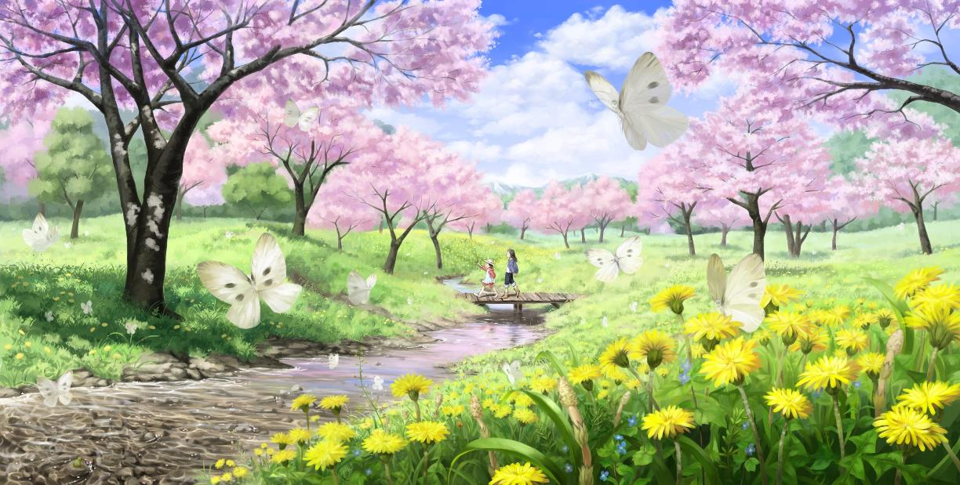
ᎪᎨᏱ
ᎠᏅᏱ
ᎧᏬᏂ
ᎠᏂᏍᎬᏗ
ᏕᎭᎷᏱ

Slide 8
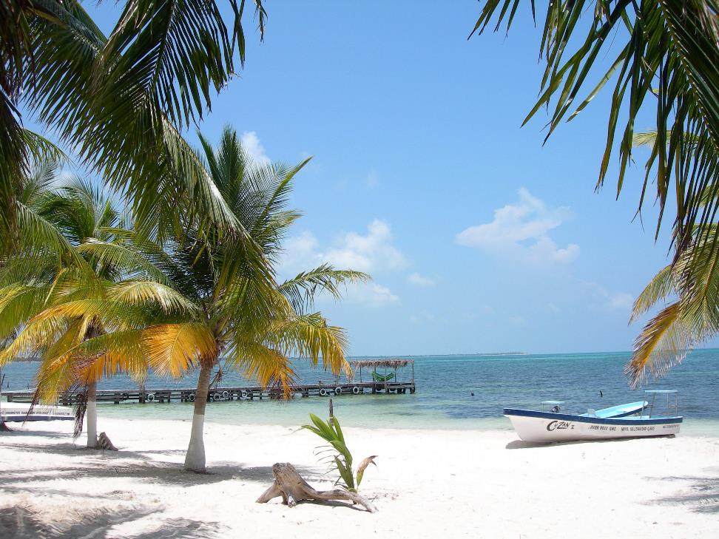
ᎪᎩ
ᎫᏰᏉᏂ
ᎦᎶᏂ
ᏚᎵᏍᏗ

Slide 9
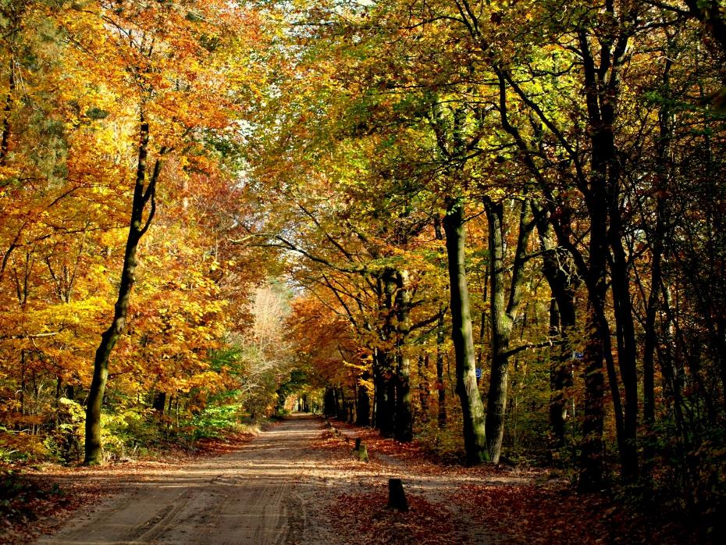
ᎤᎳᎪᎲᏍᏗ
ᏚᎵᏍᏗ
ᏚᏂᏃᏗ
ᏅᏓᏕᏆ

Slide 10
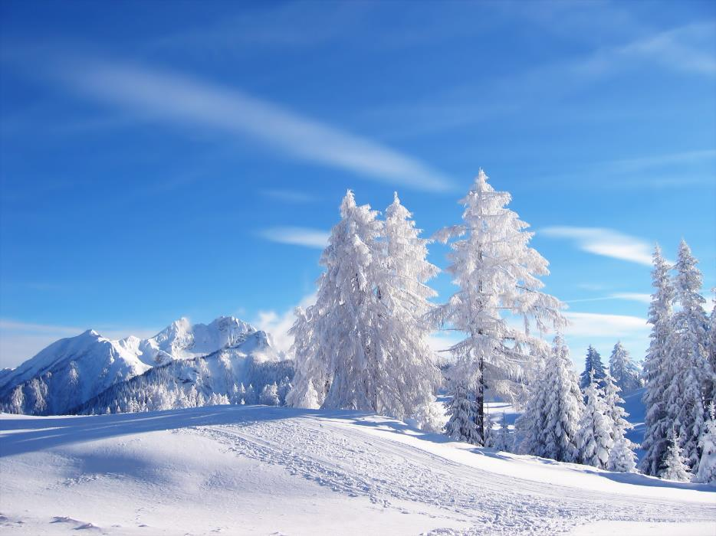
ᎪᎳ
ᎥᏍᎩᏱ
ᎤᏃᎸᏔᏅ

Slide 11
ᏧᎾᏕᏘᏱᏌᏗᏒ
ᎪᎨᏱ
ᎪᎩ
ᎤᎵᎪᎲᏍᏗ
ᎪᎳ

Slide 12
ᎨᏙ ᎢᏳᏍᏗ ᎤᏕᏘᏴᏌᏗᏒ ᎯᎠ?

Slide 13
ᎨᏙ ᎢᏳᏍᏗ ᎤᏕᏘᏴᏌᏗᏒ ᎯᎠ?

Slide 14
ᎯᎠᏛ?

