Slide 1
ᏣᎳᎩ 101
Review – Months, Birthdays

Slide 2
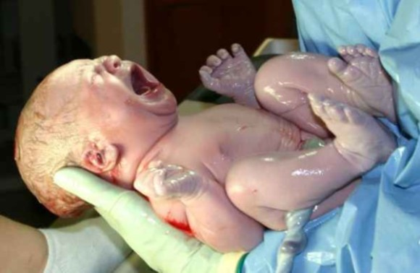
“ᎤᏕᏅᎢ"

Slide 3
ᎤᏕᏘᏱᏍᎪᎢ

Slide 4
16 ᎤᏕᏘᏴᏓ!

Slide 5
ᎢᏣᏓᏲᎵᎳ! (5x), ᎩᎶ ᏍᎪᏂ ᎠᏍᏆᏚᎸᎢ ᏧᏬᏝ!
“ᏏᏲ! ᏙᎯᏉᏧ?”
“ᎦᏨ ᏣᏕᏁᎢ?”
“ᎲᎦ ᏣᏕᏘᏴᏓ? ᎲᎳᏴ ᏣᏕᏘᏱᏍᎪᎢ?”
“ᎨᏙ ᎢᏳᏍᏗ ᏣᎸᏉᏗ ᏣᏛᏁᏗ ᎤᎾᏙᏓᏈᏕᎾ ᎨᏐᎢ?”

Slide 6
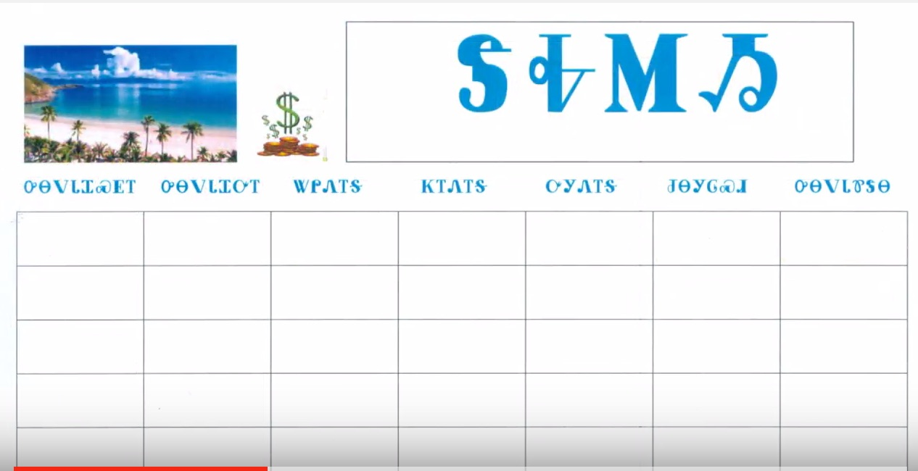
ᏗᏏᏅᏙ / ᏗᎧᎸ
01 ᎤᏃᎸᏔᏅ 07 ᎫᏰᏉᏂ
02 ᎧᎦᎵ 08 ᎦᎶᏂ
03 ᎠᏅᏱ 09 ᏚᎵᏍᏗ
04 ᎧᏬᏂ 10 ᏚᏂᏂᏗ
05 ᎠᏂᏍᎬᏗ 11 ᏅᏓᏕᏆ
06 ᏕᎭᎷᏱ 12 ᎥᏍᎩᏱ

Slide 7
ᎨᏙ ᎤᏍᏗ ᎧᎸ?
ᎤᏙᎯᏳ ᎤᏴᏣ! ᎤᎭᎨᏓ ᎦᏌᎴᎾ ᎤᏂᏩ ᎺᎵ. ᎠᎵᎮᎵᎦ ᎩᎳᏊᎢᏳᏍᏗ ᏭᎷᏣ ᏓᏂᏍᏓᏲᎯᎲᎢ.
ᎨᏙ ᎤᏍᏗ ᎧᎸ ᏃᏊ?
Ꭱ) ᏕᎭᎷᏱ Ꮘ) ᏚᎵᏍᏗ
Ꮟ) ᎥᏍᎩᏱ Ꮧ) ᏚᏂᏂᏗ

Slide 8
ᎨᏙ ᎤᏍᏗ ᎧᎸ ᏃᏊ?
ᏧᏃᏚᎯ ᏧᏆᎶᎦ - ᎩᎦᎨ, ᏓᎶᏂᎨ, ᎠᏓᎶᏂᎨ, ᏃᎴ ᎤᏬᏗᎨ ᎾᎾᎵᏍᏗᎭ. ᎩᎳᏫᏳᏍᏗ ᏭᎷᏣ ᎠᏍᎦᏰᎭ ᎢᎦ - 31^{Ᏹ} ᎢᎦ!
ᎨᏙ ᎤᏍᏗ ᎧᎸ ᏃᏊ?
Ꭱ) ᎥᏍᎩᏱ Ꮘ) ᏚᏂᏂᏗ
Ꮟ) ᎦᎶᏂ Ꮧ) ᎧᎦᎵ

Slide 9
ᎨᏙ ᎤᏍᏗ ᎧᎸ ᏃᏊ?
ᏍᏈᏍᏓ °ᎬᎾ ᏓᎾᎵᏍᏓᏴᎲᏍᎪᎢ ᎠᏂᏴᏫ ᎠᎹᏰᎵ. ᎣᏂᏗᏣ ᎧᎸ ᏧᏂᎩᎶᏍᏗ “ᎬᏂᎨᎢ ᏧᏂᎩᎶᏍᏗ” ᎠᏃᏎᎰᎢ.
ᎨᏙ ᎤᏍᏗ ᎧᎸ ᏃᏊ?
Ꭱ) ᏅᏓᏕᏆ Ꮘ) ᎫᏰᏉᏂ
Ꮟ) ᏕᎭᎷᏱ Ꮧ) ᎠᏅᏱ

Slide 10
ᎨᏙ ᎤᏍᏗ ᏑᏕᏘᏴᏌᏗᏒ ᎯᎠ?
ᎯᎠ ᏗᎧᎸ:
ᎥᏍᎩᏱ
ᎤᏃᎸᏔᏅ
ᎧᎦᎵ

Slide 11
ᎨᏙ ᎤᏍᏗ ᎤᏁᏌᏴᏌᏗᏒ ᎯᎠ?
ᎯᎠ ᏗᎧᎸ:
ᏕᎭᎷᏱ
ᎫᏰᏉᏂ
ᎦᎶᏂ

Slide 12
ᎠᎩᎸᏉᏗ / ᎠᎩᎸᏉᏗᏳ: ᎧᎩ ᎢᏳᏍᏗ ᏣᎸᏉᏗᏳ ᎧᏃᎩᏍᎩ? (5x ᏗᏥᏛᏛᎲᎦ!)
Kurt Cobain ᎠᎩᎸᏉᏗ!
PrinceᎢᏍᏊ ᎠᎩᎸᏉᏗ!
ᎠᏎᏃ…Michael Jackson ᎠᎩᎸᏉᏗᏳ!

Slide 13
ᏗᏁᎵᏙᏗ!
http://www.unc.edu/~moeng/TULIP/party_game/?lang=cherokee

