Slide 1
ᏣᎳᎩ 101
Weather and habituals

Slide 2

ᏗᏣᎴᎲᎦ ᏃᎴ ᏗᏣᏓᏲᎵᎳ! (5 ᎢᏯᏂ ᎠᏂᏴᏫ)
“ᏏᏲ! ᏙᎯᏉᏧ?”
“ᎨᏙ ᎢᏳᏍᏗ ᏣᎸᏉᏗ ᏣᏛᏁᏘ (ᏧᏂᎩᎶᏍᏗ…/ᎤᎾᏙᏓᏈᏕᎾ…/ᎤᎾᏙᏓᏆᏍᎬ… - pick a different day each time) ᎨᏐᎢ?”
“ᎭᎳᏴ ᏣᏕᏘᏱᏍᎪᎢ?”

Slide 3
ᎪᎨᏱ
ᏥᏍᏈᏍᏓ ᎠᏂᏥᎸᏍᎩ ᏓᏂᏌᏅᏃᎢ
ᎢᎾᎨ ᎠᏁᎯ ᎠᏓᎯ ᎤᎾᏕᏃᎢ
ᏥᏈᏍᏓ ᎠᎦᏍᎪᎢ

Slide 4
ᎨᏙ ᎢᏳᏍᏗ ᏂᎦᎵᏍᏗᎰᎢ ᎪᎩ ᎨᏐᎢ?
ᎤᎦᎿᏩ (ᎠᎴ ᎤᏗᎴᎦ) ᏂᎦᎵᏍᏗᎰᎢ ᏙᏱ!
ᏥᏈᏍᏓ ᎠᎦᎵᎰᎢ
ᏓᏂᏃᎩᏍᎪᎢ ᏥᏍᏆ.
ᎠᏘᏥᏍᏗ ᎠᏆᏂᏬᎢ ᏃᎴ ᎤᏍᏆᎳ ᏗᎦᎳᏱᏗ ᎠᏆᏑᏠᎢ.

Slide 5
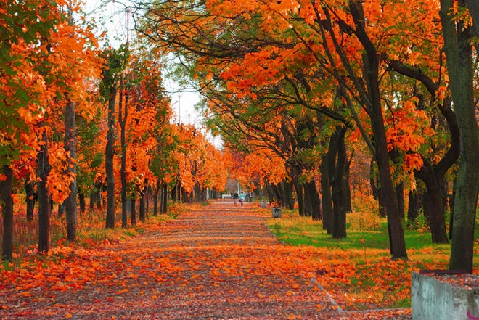
ᎤᎵᎪᎲᏍᏗ
ᏧᏃᏚᎯ ᏗᎳᏑᏫᏓ ᎾᎾᎵᏍᏗᎰᎢ ᏧᎦᎶᎦ - ᎩᎦᎨ, ᏓᎶᏂᎨ, ᏃᎴ ᎤᏬᏗᎨ.
ᎤᏁᏌᏴᏥ ᏂᎦᎵᏍᏗᎰ ᏙᏱ
ᎠᎶᏕᏍᏗ ᏓᎾᏁᏦᎥᏍᎪᎢ

Slide 6
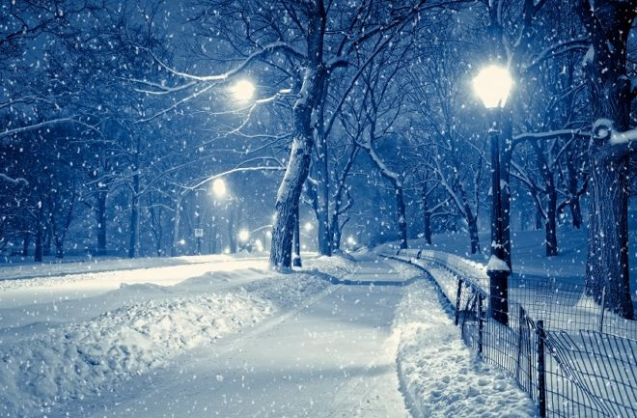
ᎨᏙ ᎢᏳᏍᏗ ᏂᎦᎵᏍᏗᎰᎢ…
ᎨᏙ ᎢᏳᏍᏗ ᏂᎦᎵᏍᏗᎰᎢ ᎪᎳ ᎨᏐᎢ?
ᎤᏴᏣ ᏂᎦᎵᏍᏗᎰᎢ!
ᎫᏘᎰᎢ!

Slide 7
ᎪᎳ ᎨᏐᎢ…
ᎨᏙ ᎢᏳᏍᏗ ᏂᎦᎵᏍᏗᎰ ᎪᎳ ᎨᏐ?
ᎤᏬᏗᎨ ᎤᎦᎾᏍᏓ ᎦᏗᏔᏍᎪᎢ!

Slide 8
ᎠᏁᎸᏙᏗ!
You have a set of descriptions that match a season. Your partner must guess which season you have!
2x ᏂᏣᏛᎦ! (switch partners)

Slide 9
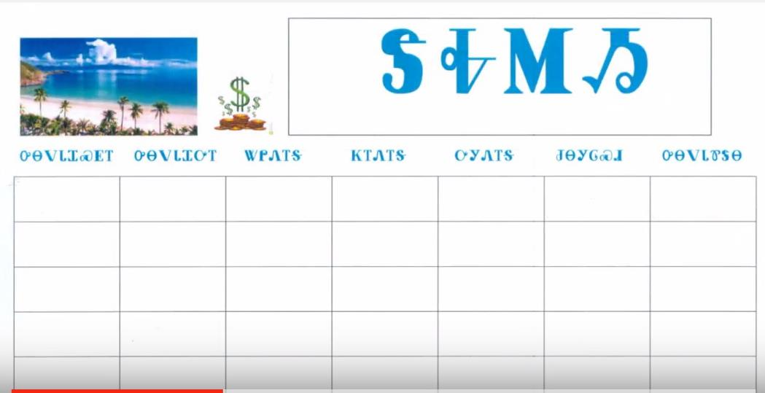
ᎨᏙ ᎢᏳᏍᏗ ᎭᏛᏁᎰᎢ ᎤᏙᏓᏆᏓ?
ᎠᏴᏃ…
ᏥᏰᎪᎢ
ᎦᏓᏬᏍᎪᎢ
ᏕᏥᎾᏙᎬ ᏕᏥᏅᎦᎵᎰᎢ

Slide 10
Ꮩ ᎭᏛᏁᎰ ᏂᎪᎯᎸ? (ᎤᏙᏓᏆᏓ)
ᏂᎪᎯᎸ ᏑᎾᎴ ᏥᏰᎪᎢ!
ᏃᏉ ᎠᏰᎦ ᏍᏗᏫ! ➔

Slide 11
Ꮩ ᎭᏛᏁᎰ ᏂᎪᎯᎸ?
ᏂᎪᎯᎸ ᎦᏓᏬᏍᎪᎢ!
ᎠᏓᏬᎠ ᏣᏂ! ➔

Slide 12
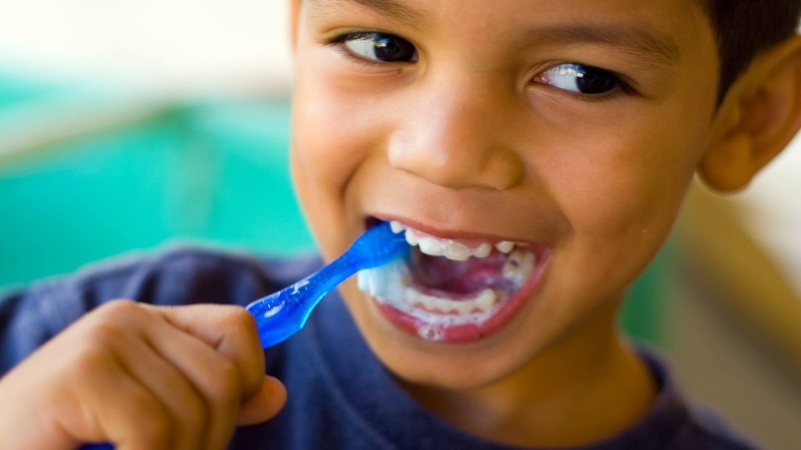
Ꮩ ᎭᏛᏁᎰ ᎤᏙᏓᏆᏓ?
ᏕᏥᎾ°ᏙᎬ ᏕᏥᏅᎦᎵᎰᎢ
ᏃᏊᏛ ᏧᎾᏙᎬ ᏧᏅᎦᎵᎠ ᏍᏗᏫ!

Slide 13
Ꮩ ᎭᏛᏁᎰ ᏂᎪᎯᎸ?
ᏥᎬᏍᏉᏍᎪᎢ!
ᎠᎬᏍᏉᎠ ᎺᎵ! ➔

Slide 14
Ꮩ ᎭᏛᏁᎰ ᏂᎪᎯᎸ?
ᎦᏓ°ᎨᏍᎪᎢ!
ᎠᏓ°ᎨᎭ ᏍᎩᎾ ᏪᏌ! ➔

Slide 15
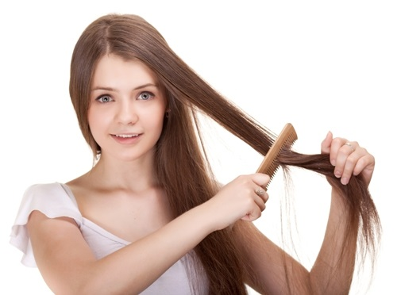
Ꮩ ᎭᏛᏁᎰ ᏂᎪᎯᎸ?
ᎦᎳᏔᏬᏍᎪᎢ!
ᎠᎳᏔᏬᎠ ᎯᎠ ᎠᎨᏯ ➔

Slide 16
Ꮩ ᎭᏛᏁᎰ ᏂᎪᎯᎸ?
ᏥᎾᏬᏍᎪᎢ ᎤᎭᎨᏓ!
ᎤᎭᎨᏓ ᎠᎿᏬᎠ Mr. Rogers ➔

Slide 17
Ꮩ ᎭᏛᏁᎰ ᏂᎪᎯᎸ?
ᎤᏅᏗ ᎦᏗᏔᏍᎪᎢ!
ᎤᏅᏗ ᎠᏗᏔᏍᎦ Ꮎ ᎠᎨᏯ. ➔

Slide 18
Ꮩ ᎭᏛᏁᎰ ᏂᎪᎯᎸ?
ᏑᎾᎴ ᎦᎳᏍᏓᏯᎲᏍᎪᎢ!
ᎪᎯ ᏑᎾᎴ ᎠᎳᏍᏓᏯᎲᏍᎦ ᎡᏗ. ➔

Slide 19
Ꮩ ᎭᏛᏁᎰ ᏂᎪᎯᎸ?
ᏗᏕᎶᏆᏍᏗ ᎨᎪᎢ!
ᏗᏕᎶᏆᏍᏗ ᎡᎦ ᏫᎵ. ➔

Slide 20
Ꮩ ᎭᏛᏁᎰ ᏂᎪᎯᎸ?
ᏓᏥᏥᎶᏍᏗᏍᎪᎢ!
ᏓᏥᎶᏍᏗᎭ ᎯᎠ ᎤᏬᏰᏂ ➔

Slide 21
Ꮩ ᎭᏛᏁᎰ ᏂᎪᎯᎸ?
ᏗᏇᏅᏒ ᎡᎳᏗ (by foot) ᎨᎪᎢ.
ᏧᏪᏅᏒ ᎡᎳᏗ ᎡᎦ Cartman.➔

Slide 22
“ᏕᏓᏓᎪᎲᏳ” ᎠᏗᎰᎢ!

Slide 23
ᏗᏁᎸᏙᏗ!
You and your partner each have part of Matthew’s daily agenda. Ask your partner: “ᎨᏙ ᎢᏳᏍᏗ ᎠᏛᏁᎰ (ᎠᎬᏱ, ᏔᎵᏁ, ᏦᎢᏁ…) ᎹᏚ” to fill in the missing information!
Switch roles – Ꭱ ➔ Ꮘ, then switch partners

