Slide 1
ᏣᎳᎩ 102
ᎨᏙ ᎢᏳᏍᏗ ᏗᎬᎾᏗᎢ?

Slide 2
ᎠᎬᏱ: ᎦᏲᏟ ᎢᏣᏓᏟᏃᎮᎯ (7 ᎢᏯᏂ ᎠᏂᏴᏫ) (ᎤᏍᏆᎳ ᎠᏟᏃᎮᏗ)
(Ꭳ)ᏏᏲ! ᎭᏲᎵᏓᏧ / ᎣᏏᏊᏍ? / ᏙᎯᏧ?
ᎨᏙ ᎭᏛᏁᎴ?
ᏙᏊ ᏣᏓᎾᏔ?

Slide 3
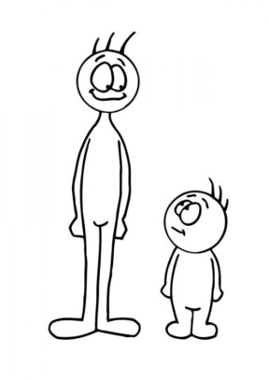
ᎨᏙ ᎢᏳᏍᏗ ᏗᎬᎾᏗᎢ? (ᎢᎾ ᎢᎦᏘ? ᎡᎳᏗ ᎢᎦᏘ?)

Slide 4
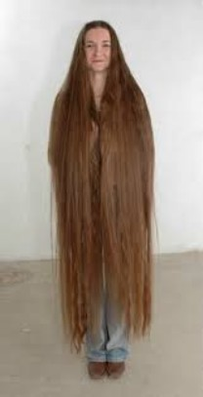
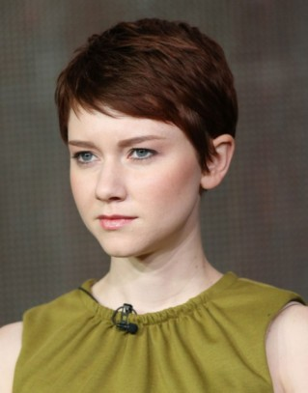
ᎬᎾᎯᏓ ᎤᏍᏗᏰᎬ? ᎤᏍᏆᎳ ᎤᏍᏗᏰᎬ?

Slide 5
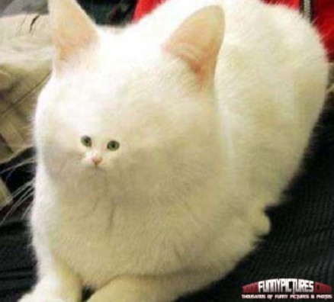
ᏧᏂᏍᏗ ᏗᎦᏙᎵ? ᏧᎾᏔᏅ ᏗᎦᏙᎵ?

Slide 6
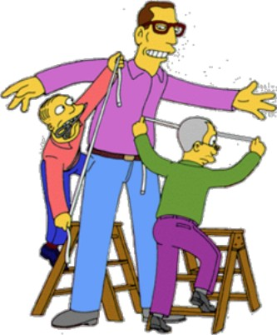
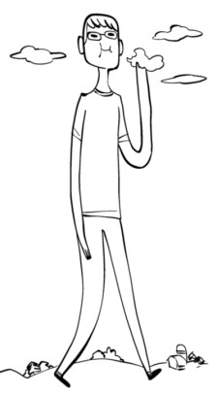
ᎡᏆ? ᎠᎴ ᎤᏙᎯᏳ ᎡᏆ? (ᎢᎾ ᎢᎦᏘ?)

Slide 7
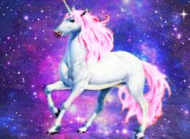
ᎤᏬᏚᎯ? ᎠᎴ ᎤᏁᎩᏟᏗ?

Slide 8
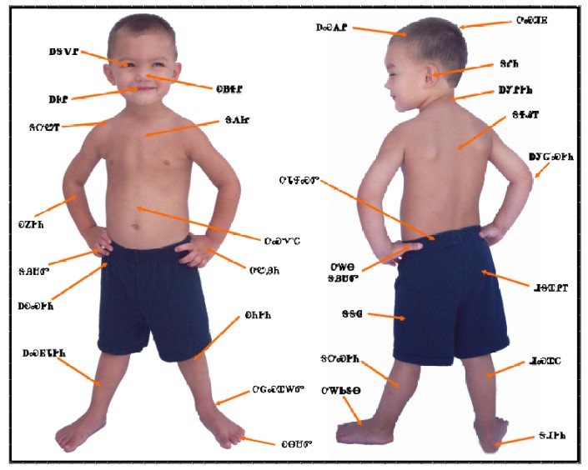
ᎠᏰᎸ

Slide 9
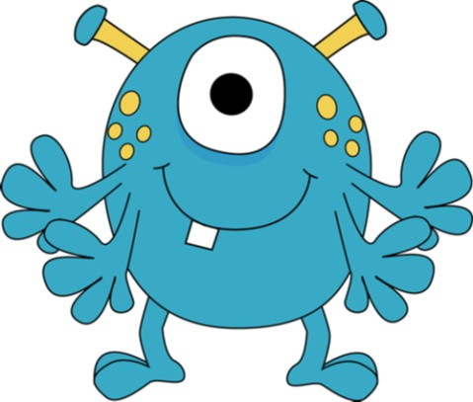
ᎠᏓᏍᎩᎵ! ᎨᏙ ᎢᏳᏍᏗ ᏗᎬᎾᏗᎢ? …ᏐᏊ ᎠᎦᏙᎵ… ᎡᎳᏗ ᎢᎦᏔ…

Slide 10
ᎠᏓᏍᎩᎵ ᏗᏥᎶᏍᏓ!
ᏐᏉ ᏴᏫ ᎠᏗ: “ᎤᏙᎯᏳ ᎢᎾ ᎢᎦᏔ ᎯᎠ ᎠᏓᏍᎩᎵ…” ᏃᎴ ᏔᎵᏁ ᏴᏫ ᏓᏥᎶᏍᏓ.
ᎨᏙ ᎢᏳᏍᏗ ᏗᎬᎾᏗᎢ ᎠᏓᏍᎩᎵ ᏣᏤᎵᎢ?

