Slide 1
ᏣᎳᎩ 102
ᎨᏙ ᎢᏳᏍᏗ ᏗᎬᎾᏗᎢ?

Slide 2
ᎢᏣᏓᏲᎵᎳ – 5 ᎢᏯᏂ ᎠᏂᏴᏫ ᎢᏥᏟᏃᎮᎯ
“ᏏᏲ, ᏙᎯᏧ / ᎣᏏᏉᏧ / ᎭᏲᎵᏓᏧ?”
“ᎣᏍᏓ (/ᎤᏲᎢ) ᏗᎬᎾᏗᎢ … (ᏣᎿᏬ / ᏕᏣᎳᏑᎶ…)”
ᎦᏨ ᏣᏩᏎᎢ… (ᏍᎩᎾ ᎠᎿᏬ / ᎠᎳᏍᏇᏔᏬ… etc.) Sears/Belk/Wal-Mart?

Slide 3
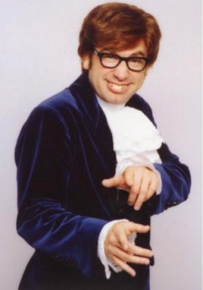
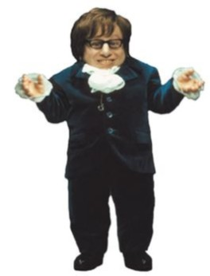
ᎨᏙ ᎢᏳᏍᏗ ᏗᎬᎾᏗᎢ?
ᎢᎾ ᎢᎦᏔ
ᎡᎳᏗ ᎢᎦᏔ

Slide 4
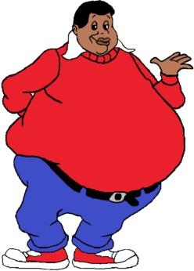
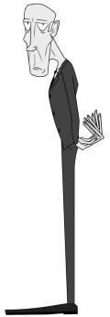
ᎨᏙ ᎢᏳᏍᏗ ᏗᎬᎾᏗᎢ?
ᎦᎵᏦᎯᏓ
ᎤᎴᏐᏓ

Slide 5
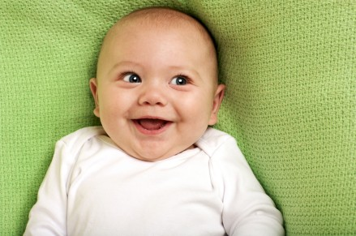
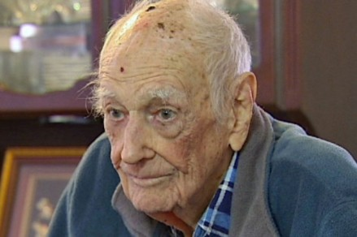
ᎨᏙ ᎢᏳᏍᏗ ᏗᎬᎾᏗᎢ?
ᎠᏲᏟ
ᎠᎦᏴᎵ

Slide 6
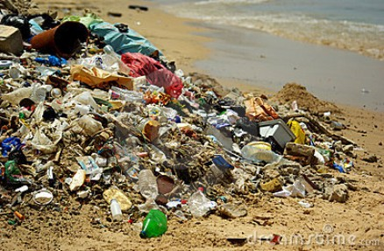
ᎨᏙ ᎢᏳᏍᏗ ᏗᎬᎾᏗᎢ?
ᎤᏬᏚᎯ
ᎤᏁᎩᏟᏗ

Slide 7
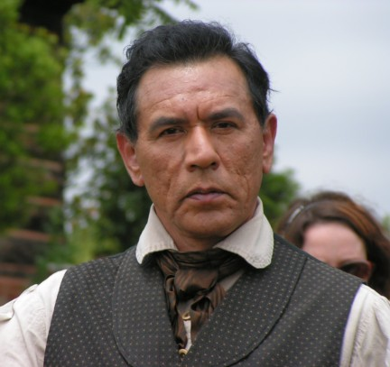
ᎨᏙ ᎢᏳᏍᏗ ᏗᎬᎾᏗᎢ ᎯᎠ ᏴᏫ?
ᎢᎾ ᎢᎦᏔ? ᎠᎴ ᎡᎳᏗ ᎢᎦᏔ?
ᎤᏬᏚᎯ ᎠᎴ ᎤᏁᎩᏟᏗ?
ᎠᏲᏟ ᎠᎴ ᎠᎦᏴᎵ?
ᎨᏙ ᎢᏳᏍᏗ ᎤᎿᏩ?

Slide 8
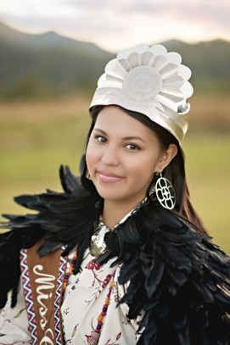
ᎨᏙ ᎢᏳᏍᏗ ᏗᎬᎾᏗᎢ ᎯᎠ ᏴᏫ?

Slide 9
ᏍᏓᎵᎢ ᎯᏃᎯᏏ!
ᎨᏙ ᎢᏳᏍᏗ ᏗᎬᎾᏗᎢ ᏗᎦᏃᏣᎵ (famous) ᏴᏫ?
ᏍᏓᎵᎢ ᎯᏃᎯᏏ.
ᏄᏓᎴ ᏴᏫ ᎠᏁᏟᏗᏍᎨᏍᏗ ᎢᏰᎵᏍᏗ ᎧᎩ ᎢᏳᏍᏗ.

Slide 10
ᏗᏤᏅᏒ ᏕᏣᎸᏫᏍᏓᏁᏗ
Think of 3 commonly-used verbs; things like “see, say, know, write, work…etc” – make sure they are in the stem dictionary
Write/type out the conjugations of them for 1st & 3rd person singular in the present continuous stem.
Use the stem dictionary to write out forms for 1st & 3rd singular in the incompletive, completive, and deverbal noun stems.

