Slide 1
ᏣᎳᎩ 102
ᏩᎭᏯ ᏥᏚᎳᏑᏝᏅ 03

Slide 2
ᏗᏣᎴᎲᎦ! ᎢᏣᏓᏲᎵᎳ.
3 ᎢᏯᏂ ᎠᏂᏴᏫ – 2 ᏗᎦᏍᎩᎸ.
“ᏏᏲ…”
  “ᏙᎯᏧ?” / “ᎭᏲᎵᏓᏧ?” / “ᎣᏏᏊᏧ?”
  “Ꮩ ᎭᏛᏁᎴᎢ ᎤᎾᏙᏓᏈᏕᎾ ᏥᎨᏒ?”
  “ᎤᏬᏍᏗᏍ* ᎨᎮᎢ?” ^{*fun/funny}
  “ᎣᏏᏊᏍ ᏧᎾᏕᎶᏆᏍᏗ?”

Slide 3
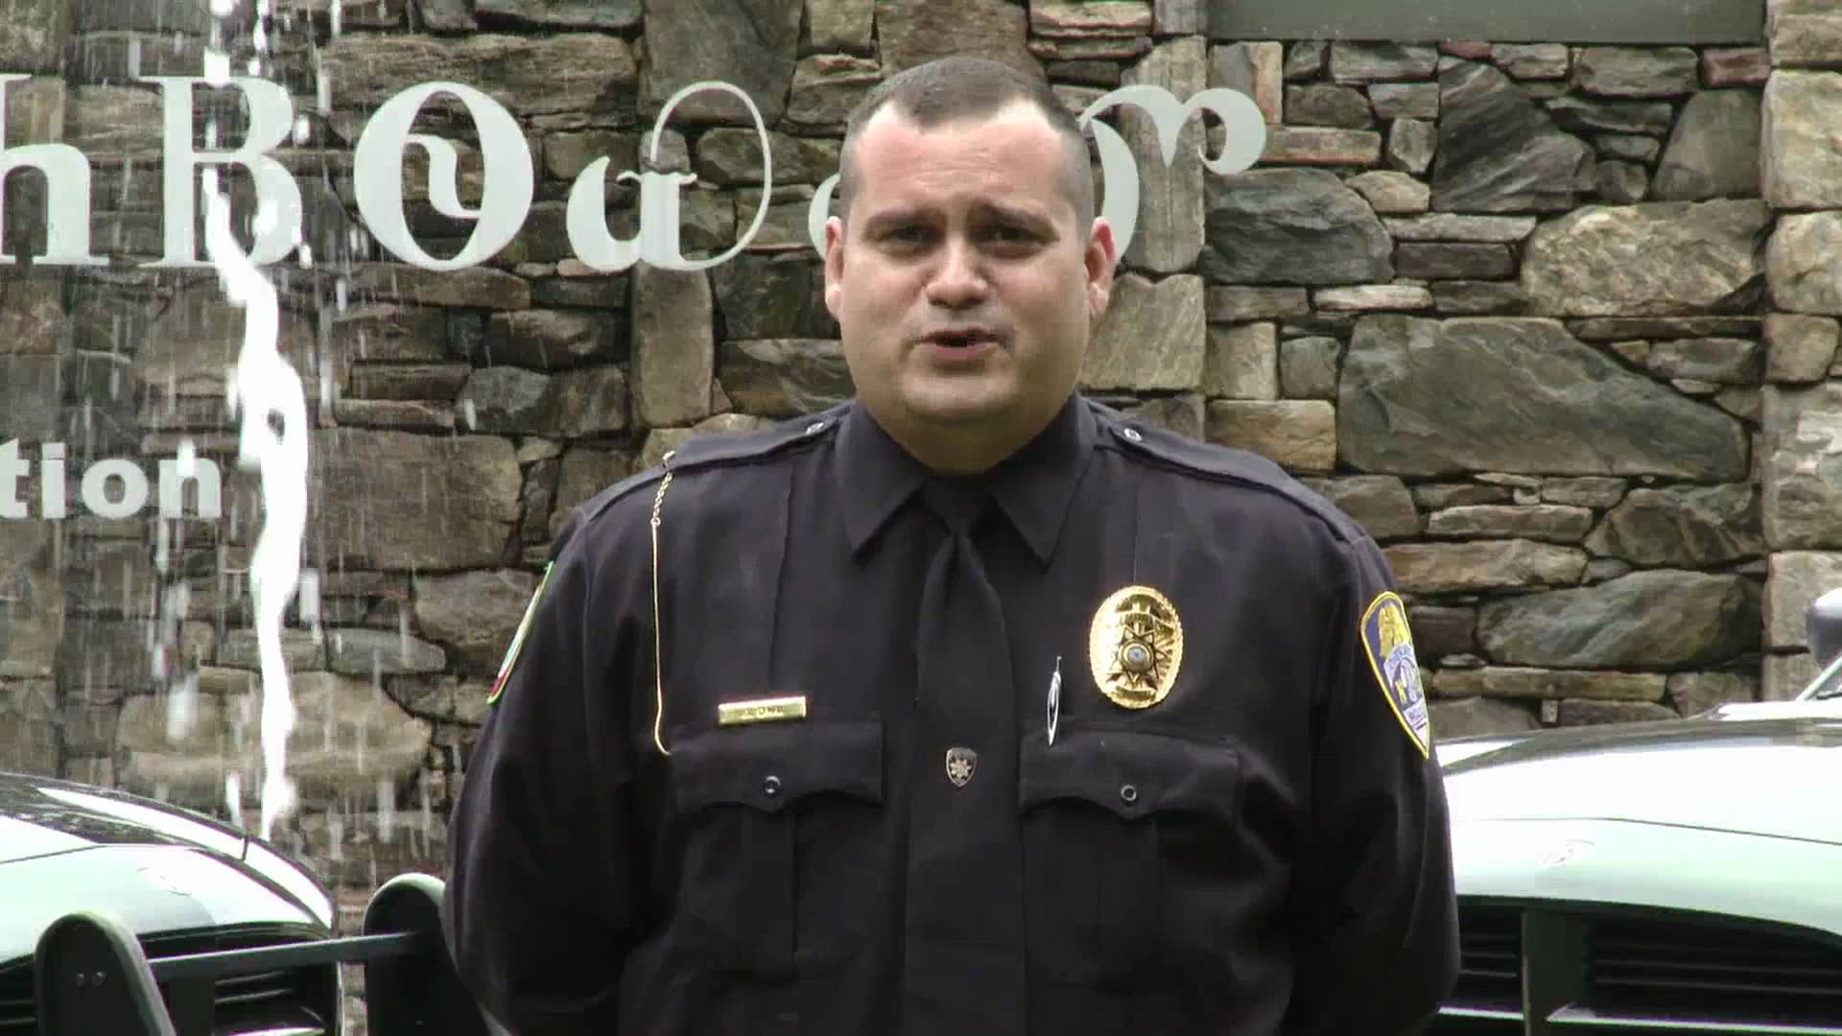
ᎧᎩ ᎢᏳᏍᏗ ᎯᎠ…?
...ᏗᏓᎾᏥᏍᎩ!

Slide 4
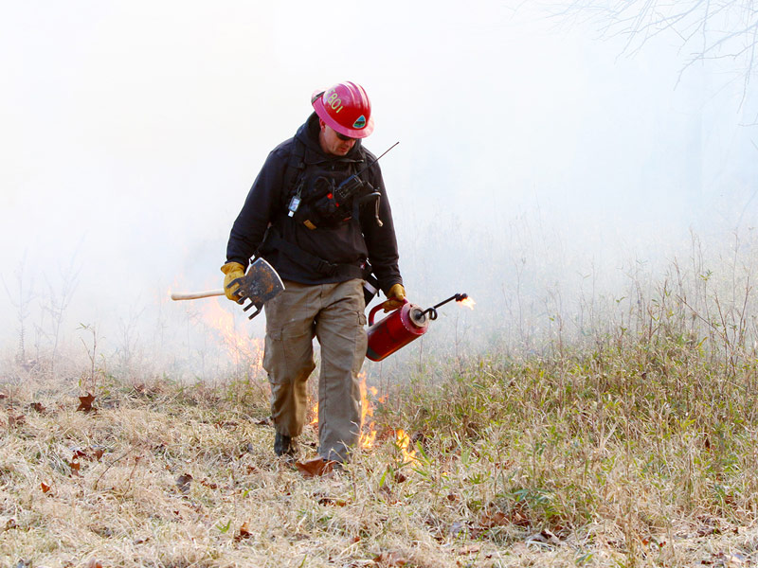
ᎧᎩ ᎢᏳᏍᏗ ᎯᎠ…?
...ᎠᏥᎳ ᎠᏓᎳᏗᏍᎩ

Slide 5
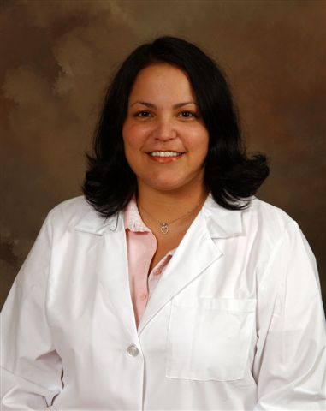
ᎧᎩ ᎢᏳᏍᏗ ᎯᎠ?
…ᎦᎾᎧᏘ!

Slide 6
ᎨᏙ ᎢᏳᏍᏗ ᏄᎾᏓᎴ ᏧᏂᎸᏫᏍᏓᏁᏗ?
“ᏗᏕᏲᎲᏍᎩ ᎾᏆᎵᏍᏙᏗ ᎠᏆᏚᎵᎭ!”
ᎠᏓᏍᏓᏲᎲᏍᎩ - ᏣᎳᎩᏱ ᎤᎬᏫᏳᎯ
ᎦᎾᎦᎵᎯᏙᎯ - ᎠᎹᏰᏟ ᏂᎬᎾᏛ ᎤᎬᏫᏳ
ᎬᎾᎯᏓ ᏓᏆᎴᎳ ᎠᏰᎵᏙᎯ - ᏗᏘᏲᎯᎯ
ᏕᎬᎾᏙᎬ ᎣᏍᏓ ᎢᏓᎬᏁ ᎦᏂᎧᏘ - ᏣᎳᎩ ᏗᏂᎳᏫᎩ
ᏗᎪᏪᎵ ᏗᎦᏅᏂᏙᎯ - ᎠᎵᏥᏙᎲᏍᎩ
ᎠᎵᏍᏓᏴᏗ ᎠᏓᎧᏘᏱ - ᎦᎸᎶᎯ ᏪᏙᎯ
ᎨᏙ ᎢᏳᏍᏗ ᏂᏣᎵᏍᏙᏗ* ᏣᏚᎵᎭ? ^{*become}

Slide 7

ᏩᎭᏯ ᏥᏚᎳᏑᏝᏅ - 03
ᎠᎩ it is
ᎠᏂᏐ others
ᏚᏂᎳᏏᏕᎾ their feet
ᏚᏁᏍᏓᏁᎰ they hurt
ᏱᏚᏂᎳᏑᏝ if they don’t wear s.
ᎤᏩᎾᏖ (s)he knew
ᎠᎵᏍᎪᏍᎬ (s)he was lying
ᎠᏒᏛ trap
ᏕᏥᏰᏲᎾ I will teach him/her

