Slide 1
ᏣᎳᎩ 101 - ᏑᏓᎵᏁ ᎢᎦ
ᏗᏕᏲᎲᏍᎩ .ᏚᏯ

Slide 2
ᏏᏲ!
Homework ᏍᎩᎾᎥᏏ.
ᎢᏣᏕᎳᎰᎯᏍᏗᏍ ᎢᏣᏚᎵ?

Slide 3
ᎢᏣᏓᏲᎵᎳ!
  4 ᎢᏯᏂ ᎠᎯᏴᏫ ᏗᏥᏝᏃᎮᏝ. 4 iyani aniyvwi ditsitlanohetla!
  ᎢᏣᏓᏲᎵᎳ! “itsadayolila!
    “ᏏᏲ! ᎣᏏᏉᏧ?” “Siyo! Osigwotsu?”
    “ᎦᎵᎡᎵᎦ ᏥᎬᎪᏩᏔ!” “Gali’eliga tsigvgowata!”
  3 ᏧᎾᏕᎳᎰᎯᏍᏙᏗ ᎢᏣᏓᏔᏓᎲᎦ. 3 tsunadelahohisdodi itsadatadahvga.

Slide 4
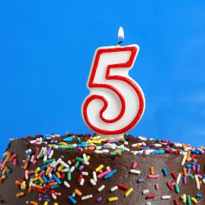
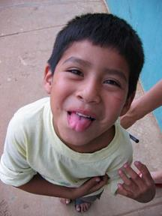
ᎲᎦ ᎢᎦ ᏗᏣᏕᏘᏴᏓ?
Hvga iga ditsadetiyvda?
5 ᏚᏕᏘᏴᏓ
5 dudetiyvda
ᎯᎠ ᎠᏧᏣ!
Hi’a atsutsa!

Slide 5

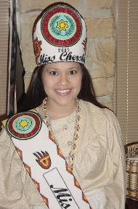
ᎲᎦ ᎢᎦ ᏗᏣᏕᏘᏴᏓ?
Hvga iga ditsadetiyvda?
ᏁᎳᏚ ᏚᏕᏘᏴᏓ
18 dudetiyvda
ᎯᎠ ᎠᏔ
Hi’a ata

Slide 6
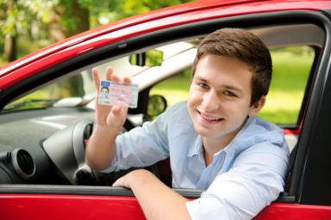
ᎲᎦ ᎢᎦ ᏗᏣᏕᏘᏴᏓ?
Hvga iga ditsadetiyvda?
ᏓᎳᏚ ᏓᏆᏕᏘᏴᏓ!
16 dagwadetiyvda!

Slide 7
ᏗᏥᏲᎯ .ᎩᎶᎢ… ditsiyohi kilo’i…
19 ᏚᏕᏘᏴᏓ …ᏃᎴ ᎪᎱᏍᏗ ᏄᏓᎴ!
21 ᏚᏕᏘᏴᏓ
18 ᏚᏕᏘᏴᏓ “siyo! Hvga iga ditsadetiyvda?”
32 ᏚᏕᏘᏴᏓ “____ dagwadetiyvda. Nihina?”
20 ᏚᏕᏘᏴᏓ

Slide 8
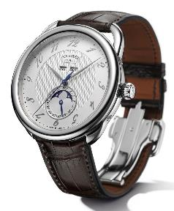
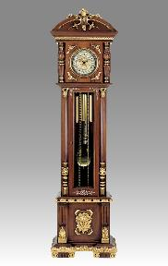
Ꭷ! ᎯᎠ…
ᏩᏥ - watsi
ᎤᏔᏅ ᏩᏥ - utanv watsi

Slide 9
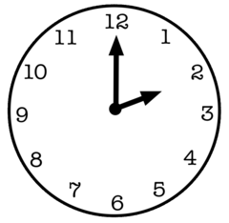
ᎲᎦ ᎢᏳᏩᏂᎸᎢ? 2 ᎢᏳᏩᏂᎸᎢ! hvga iyuwahnilv’i? 2 iyuwahnilv’i!

Slide 10
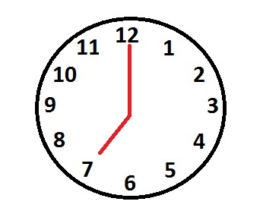
ᎲᎦ ᎢᏳᏩᏂᎸᎢ?
Hvga iyuwahnilv’i?

Slide 11

ᎲᎦ ᎢᏳᏩᏂᎸᎢ?
Hvga iyuwahnilv’i?

Slide 12
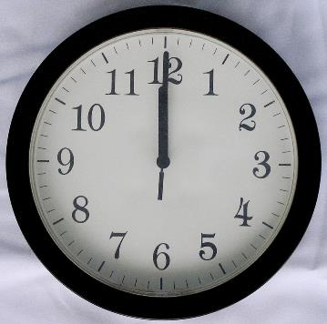
ᎲᎦ ᎢᏳᏩᏂᎸᎢ?
Hvga iyuwahnilv’i?

Slide 13

ᎲᎦ ᎢᏳᏩᏂᎸᎢ?
Hvga iyuwahnilv’i?
5 ᎢᏔᏬᏍᏓᏅᎯ ᎤᎶᏒᏍᏗ 2
5 itawosdanvhi ulosvsdi 2.

Slide 14

ᎲᎦ ᎢᏳᏩᏂᎸᎢ?
Hvga iyuwahnilv’i?

Slide 15

ᎲᎦ ᎢᏳᏩᏂᎸᎢ?
Hvga iyuwahnilv’i?

Slide 16

ᎲᎦ ᎢᏳᏩᏂᎸᎢ?
Hvga iyuwahnilv’i?

Slide 17

ᎲᎦ ᎢᏳᏩᏂᎸᎢ?
Hvga iyuwahnilv’i?
ᏔᎵ ᎠᏰᏟ!
Ta’li ayehli!

Slide 18
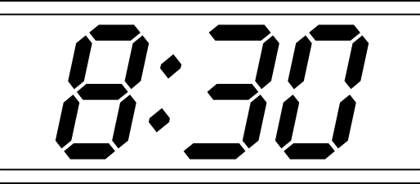
ᎲᎦ ᎢᏳᏩᏂᎸᎢ?
Hvga iyuwahnilv’i?

Slide 19

ᎲᎦ ᎢᏳᏩᏂᎸᎢ?
Hvga iyuwahnilv’i?

Slide 20

ᎲᎦ ᎢᏳᏩᏂᎸᎢ?
Hvga iyuwahnilv’i?

Slide 21

ᎲᎦ ᎢᏳᏩᏂᎸᎢ?
Hvga iyuwahnilv’i?
ᎯᏍᎩ ᎢᏔᏬᏍᏓᏅᎯ ᎤᏓᎷᎳ ᏔᎵᏚ.
Hisgi itawosdanvhi udalula talidu.

Slide 22

ᎲᎦ ᎢᏳᏩᏂᎸᎢ?
Hvga iyuwahnilv’i?

Slide 23
ᏗᏦᏪᎳᎦ!
Ditsohwelaga!
Write the following in words:
  8:30 3:45
  9:55 2:50
  5:00 12:35
  6:25 1:00
  7:10 6:15

Slide 24
ᏗᏦᏪᎳᎦ!
Ditsohwelaga!
Write the following in words:
  8:30 – tsanela ayehli
  9:55 – hisgi itawosdanvhi udalula sgohi
  5:00 – hisgi iyuwahnilv’i
  6:25 – talisgo hisgi itawosdanvhi ulosvsdi sudali
  7:10 – sgohi itawosdanvhi ulosvsdi galikwogi

Slide 25
ᏗᏦᏪᎳᎦ!
Ditsohwelaga!
Write the following in words:
  3:45 – hisgadu itawosdanvhi udalula nvhgi
  2:50 – sgohi itawosdanvhi udalula tso’i
  12:35 – talisgo hisgi itawosdanvhi udalula sogwo / tsosgo hisgi itawosdanvhi ulosvsdi talidu
  1:00 – sogwo iyuwahnilv’i
  6:15 – hisgadu itawosdanvhi ulosvsdi sudali

Slide 26

ᎤᏒᎯ ᎠᎴ ᎢᎦ?
Usvhi ale iga?

Slide 27
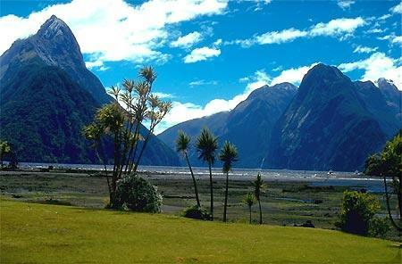
ᎤᏒᎯ ᎠᎴ ᎢᎦ?

Slide 28

ᎤᏒᎯ ᎠᎴ ᎢᎦ?
Usvhi ale iga?

Slide 29
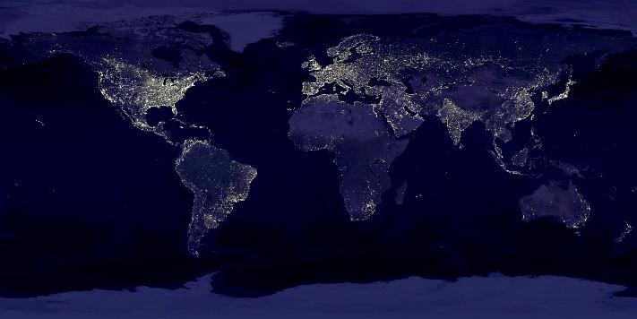
ᎤᏒᎯ ᎠᎴ ᎢᎦ?
Usvhi ale iga?

Slide 30
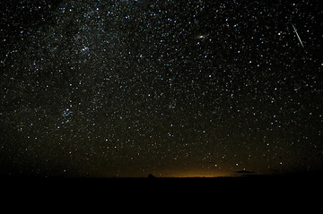
ᎤᏒᎯ ᎠᎴ ᎢᎦ?
Usvhi ale iga?

Slide 31
Homework!
READ: CH. 03 - Work and Community Life
WRITE: 3.1, 3.3
STUDY: Syllabary rows 4-5

