Slide 1
ᏣᎳᎩ 101 - ᎦᎵᏉᎩᏁ ᎢᎦ
ᏗᏕᏲᎲᏍᎩ ᏚᏯ

Slide 2
ᏏᏲ!
ᎪᎱᏍᏗ.Ꭸ ᏗᏣᏕᎳᎰᎯᏍᏗ ᎢᏣᏚᎵ?
  Gohusdike ditsadelahohisdi itsaduli?
ᏗᏤᏅᏒᎢ ᏗᏣᎸᏫᏍᏓᎾᏘ ᏍᎩᎾᎥᏏ!
  Ditsenvsv’i ditsalvwisdanti sgina’vsi!

Slide 3
Sometimes…there are mistakes.
“ᏔᏑᎳ / ᏔᏑᎳᎩ”
“ᏩᏌᎩ:Ꭰ / ᏩᏌᎩᎠ”
“ᎠᎩᏰᎳᎭ / ᎠᎩᏰᎳᎲ”
…ᎠᏆᏤᎵ / ᎠᏆᏙᎵ

Slide 4
Syllabary “look alikes”
Ꭶ - ga Ꮥ - de
Ꮳ - tsa Ꮆ - lo
Ꮃ - la Ꮤ - ta
Ꭹ - gi Ꮍ - mu
Ꮩ - do Ꮴ - tse
Ꭱ - e Ꮢ - sv

Slide 5
Prefixes
Agi- / agw- + ‘aduliha’ ➔ agw- -aduliha ➔ agwaduliha
Ts(a)- + ‘aduliha’ ➔ ts- -aduliha ➔ tsaduliha
U- + ‘aduliha’ ➔ u- -aduliha ➔ uduliha
un(i)- + ‘aduliha’ ➔ un- -aduliha ➔ unaduliha
Remember: Vowels kinda hate each other and need to be separated. They do not play nice. (In fact, they fight...)

Slide 6
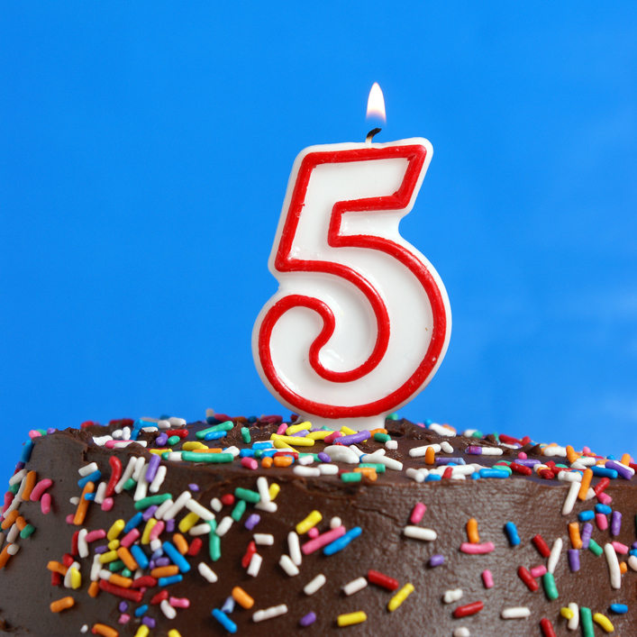
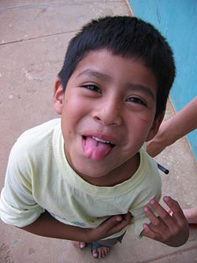
ᎲᎦ ᎢᎦ ᏗᏣᏕᏘᏴᏓ ᎯᎠ ᎠᏧᏣ?
Hvga iga dudetiyvda hi’a atsutsa?
__ ᏚᏕᏘᏴᏓ
__ dudetiyvda
ᎯᎠ ᎠᏧᏣ!
Hi’a atsutsa!

Slide 7
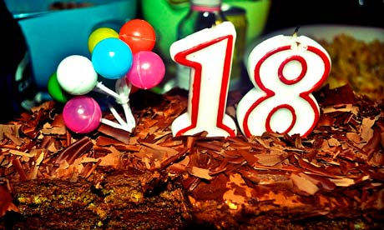
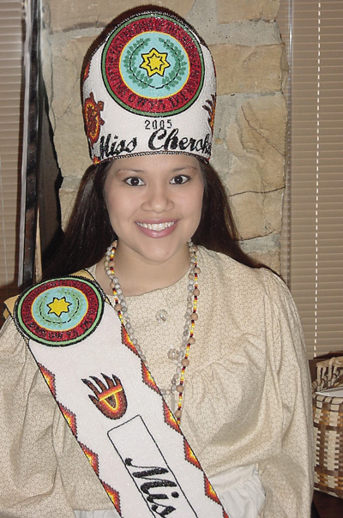
ᎲᎦ ᎢᎦ ᏚᏕᏘᏴᏓ ᎯᎠ ᎠᏔ?
Hvga iga dudetiyvda hi’a ata?
ᏁᎳᏚ ᏚᏕᏘᏴᏓ
__ dudetiyvda
ᎯᎠ ᎠᏔ
Hi’a ata

Slide 8
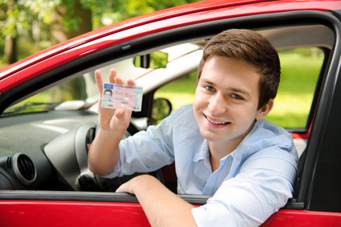
ᏏᏲ! ᎲᎦ ᎢᎦ ᏗᏣᏕᏘᏴᏓ?
Siyo! Hvga iga ditsadetiyvda?
____ ᏓᏆᏕᏘᏴᏓ!
16 dagwadetiyvda!

Slide 9
ᎢᏣᏓᏲᎵᎳ! (4 ᎢᏯᏂ ᎠᏂᏴᏫ)
A: ᏏᏲ! ᎣᏏᏊᏍ? Siyo! Osigwus?
B: ᎥᎥ, ᎣᏏᏊ. ᏂᎯᎾ? Vv, osigwu. Nihina?
A: ᎣᏏᏊ. ᎲᎦ ᎢᎦ ᏗᏣᏕᏘᏴᏓ? Osigwu. Hvga iga ditsadetiyvda?
B: ______ ᏓᏆᏕᏘᏴᏓ. ᏂᎯᎾ? ___ dagwadetiyvda. Nihina?
A: ______ ᏓᏆᏕᏘᏴᏓ. ___ dagwadetiyvda.
B: ᎣᏏᏊᏛ! ᏕᎾᏓᎪᎲᏳ! Osigwudv! Denadagohvyu!
A: ᎭᏩ. Hawa!

Slide 10

Ꭷ! ᏃᏉ ᎢᏗᎶᏆᏍᎨᏍᏗ…
ᏂᎦᎵᏍᏗᎲᎢ!
Nigalisdihv’i!

Slide 11

ᎤᏒᎯ ᎠᎴ ᎢᎦ?
Usvhi ale iga?

Slide 12
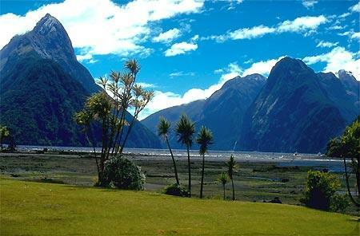
ᎤᏒᎯ ᎠᎴ ᎢᎦ?
Usvhi ale iga?

Slide 13

ᎤᏒᎯ ᎠᎴ ᎢᎦ?
Usvhi ale iga?

Slide 14
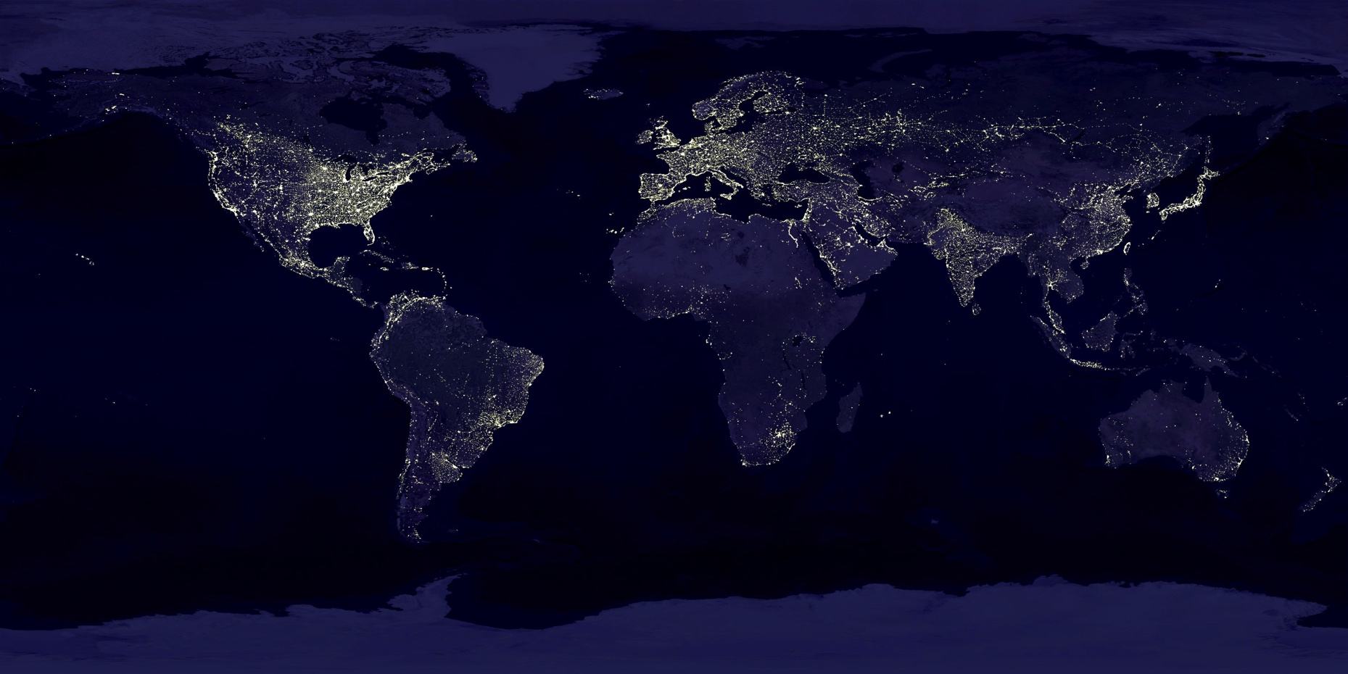
ᎤᏒᎯ ᎠᎴ ᎢᎦ?
Usvhi ale iga?

Slide 15
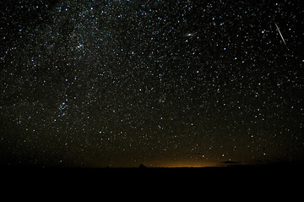
ᎤᏒᎯ ᎠᎴ ᎢᎦ?
Usvhi ale iga?

Slide 16
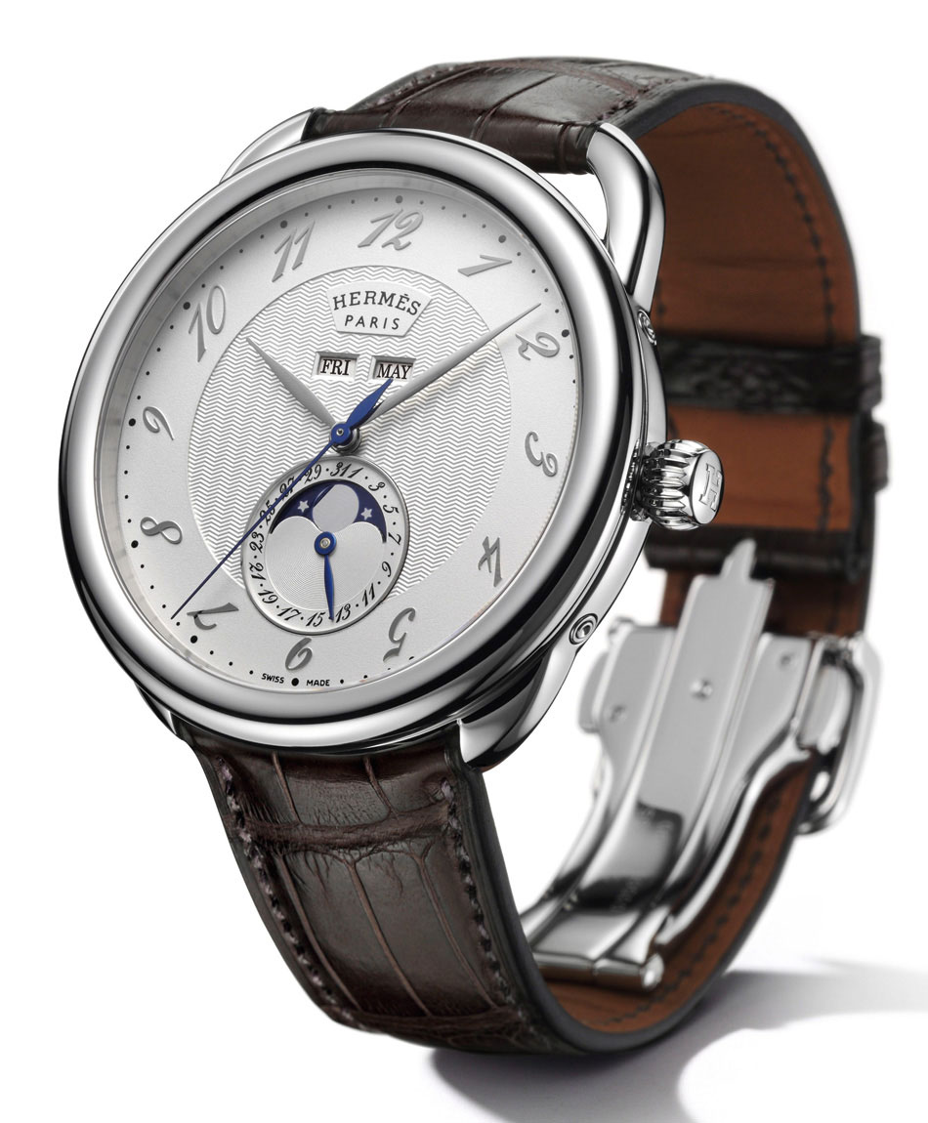
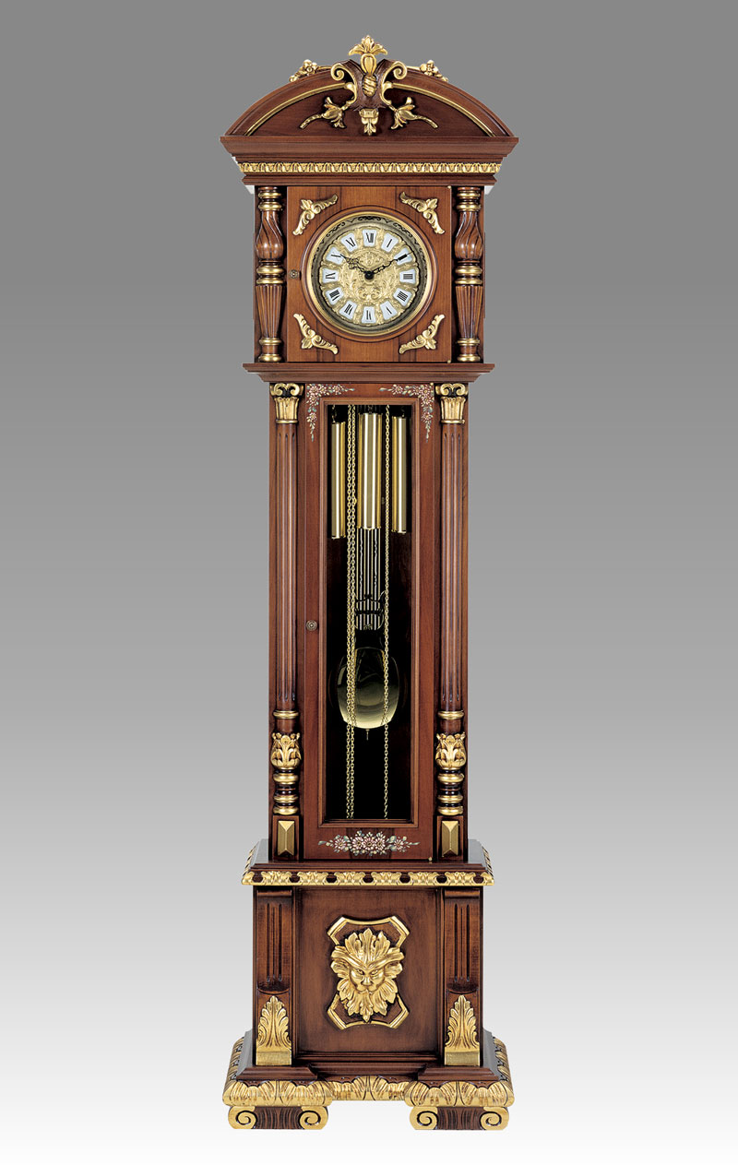
ᏃᏊᏃ… ᎯᎠ… nogwuhno… hi’a…
ᏩᏥ - watsi
ᎤᏔᏅ ᏩᏥ - utanv watsi

Slide 17

ᎲᎦ ᎢᏳᏩᏂᎸᎢ? 2 ᎢᏳᏩᏂᎸᎢ! hvga iyuwahnilv’i? 2 iyuwahnilv’i!

Slide 18
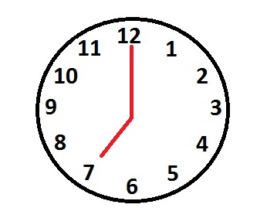
ᎲᎦ ᎢᏳᏩᏂᎸᎢ?
Hvga iyuwahnilv’i?

Slide 19

ᎲᎦ ᎢᏳᏩᏂᎸᎢ?
Hvga iyuwahnilv’i?

Slide 20

ᎲᎦ ᎢᏳᏩᏂᎸᎢ?
Hvga iyuwahnilv’i?

Slide 21

ᎲᎦ ᎢᏳᏩᏂᎸᎢ?
Hvga iyuwahnilv’i?
5 ᎢᏔᏬᏍᏓᏅᎯ ᎤᎶᏒᏍᏗ 2
5 itawosdanvhi ulosvsdi 2.

Slide 22

ᎲᎦ ᎢᏳᏩᏂᎸᎢ?
Hvga iyuwahnilv’i?

Slide 23

ᎲᎦ ᎢᏳᏩᏂᎸᎢ?
Hvga iyuwahnilv’i?

Slide 24

ᎲᎦ ᎢᏳᏩᏂᎸᎢ?
Hvga iyuwahnilv’i?

Slide 25

ᎲᎦ ᎢᏳᏩᏂᎸᎢ?
Hvga iyuwahnilv’i?
ᏔᎵ ᎠᏰᏟ!
Ta’li ayehli!

Slide 26
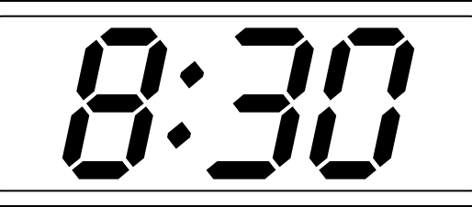
ᎲᎦ ᎢᏳᏩᏂᎸᎢ?
Hvga iyuwahnilv’i?

Slide 27

ᎲᎦ ᎢᏳᏩᏂᎸᎢ?
Hvga iyuwahnilv’i?

Slide 28

ᎲᎦ ᎢᏳᏩᏂᎸᎢ?
Hvga iyuwahnilv’i?

Slide 29

ᎲᎦ ᎢᏳᏩᏂᎸᎢ?
Hvga iyuwahnilv’i?
ᎯᏍᎩ ᎢᏔᏬᏍᏓᏅᎯ ᎤᏓᎷᎳ ᏔᎵᏚ.
Hisgi itawosdanvhi udalula talidu.

Slide 30

ᎲᎦ ᎢᏳᏩᏂᎸᎢ?
Hvga iyuwahnilv’i?

Slide 31
ᏗᏦᏪᎳᎦ!
Ditsohwelaga!
Write the following in words:
  8:30 3:45
  9:55 2:50
  5:00 12:35
  6:25 1:00
  7:10 6:15

Slide 32
ᏗᏦᏪᎳᎦ!
Ditsohwelaga!
Write the following in words:
  8:30 – tsanela ayehli
  9:55 – hisgi itawosdanvhi udalula sgohi
  5:00 – hisgi iyuwahnilv’i
  6:25 – talisgo hisgi itawosdanvhi ulosvsdi sudali
  7:10 – sgohi itawosdanvhi ulosvsdi galikwogi

Slide 33
ᏗᏦᏪᎳᎦ!
Ditsohwelaga!
Write the following in words:
  3:45 – hisgadu itawosdanvhi udalula nvhgi
  2:50 – sgohi itawosdanvhi udalula tso’i
  12:35 – talisgo hisgi itawosdanvhi udalula sogwo / tsosgo hisgi itawosdanvhi ulosvsdi talidu
  1:00 – sogwo iyuwahnilv’i
  6:15 – hisgadu itawosdanvhi ulosvsdi sudali

Slide 34
ᏗᏤᏅᏒᎢ ᏗᏥᎸᏫᏍᏓᏁᏗ Ditsenvsv’i ditsilvwisdanedi
REVIEW: Set A & Set B prefixes, Homeworks & practice conversations
STUDY: Syllabary rows 4-5
LISTEN: https://soundcloud.com/tsalagiseli/little-people-master-8-18-11

