Slide 1
ᏣᎳᎩ 102
Clothes, Seasons, Infinitives 02

Slide 2
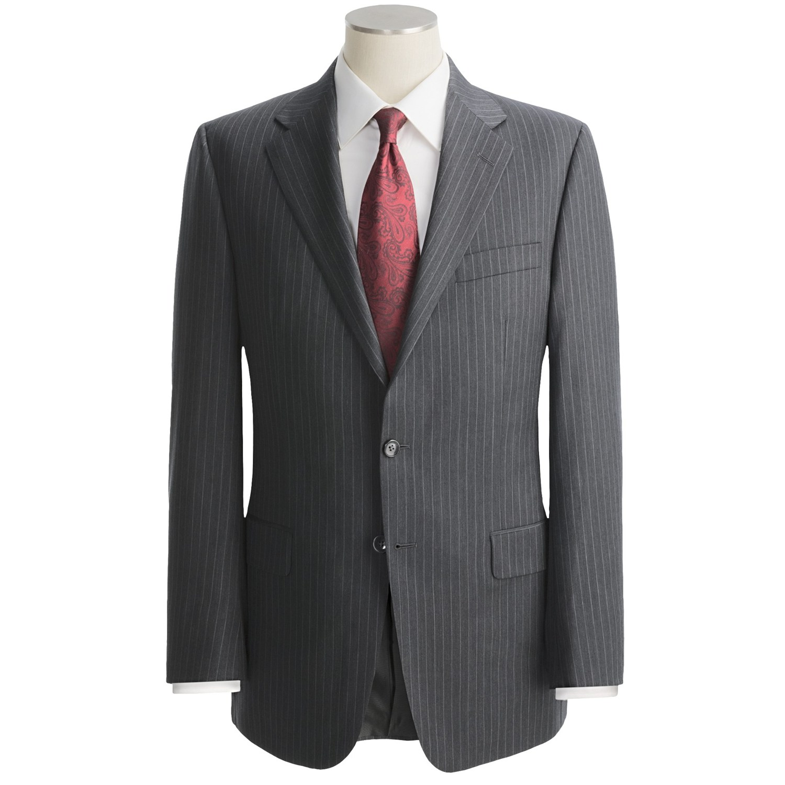
ᎨᏙ ᎢᏳᏍᏗ ᏓᏆᎿᏩ?
ᎤᎳᏍᎨᏗ ᏗᎿᏬᏍᏗ

Slide 3
ᎨᏙ ᎢᏳᏍᏗ ᏓᏆᎿᏩ?
ᎠᎧᏁᏍᏗ ᎠᏴᏣᏓ

Slide 4
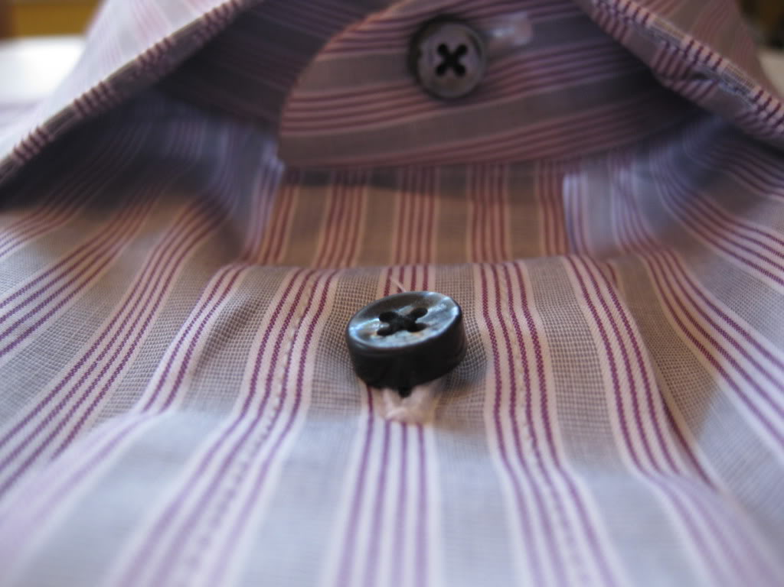
ᎨᏙ ᎢᏳᏍᏗ ᏓᏆᎿᏩ?
ᏗᎧᏁᏍᏗ
“ᎠᎧᏁᏍᏗ” / ᏗᎧᏁᏍᏗ…

Slide 5
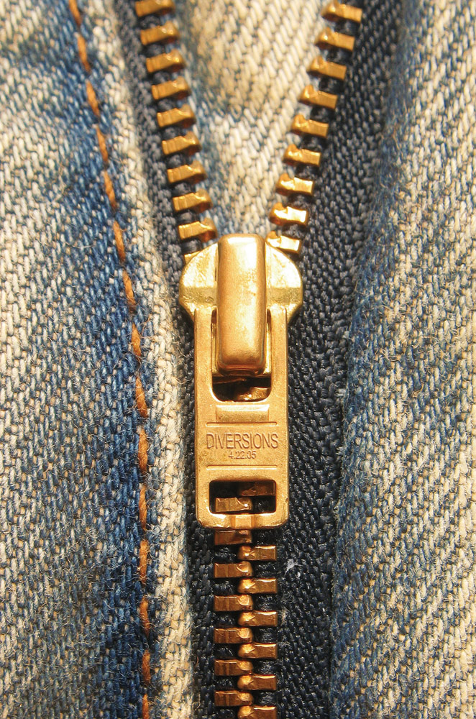
ᎨᏙ ᎢᏳᏍᏗ ᏓᏆᎿᏩ?
ᏗᎧᏁᏍᏗ

Slide 6
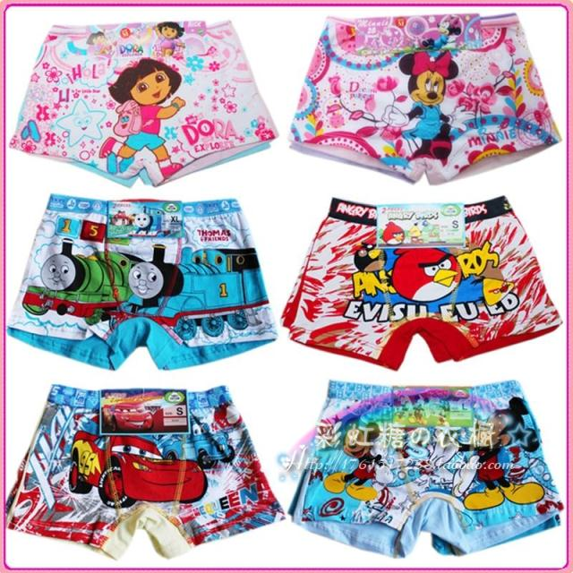
ᎯᎠᏍᏊ…
ᎭᏫᎾ ᎠᏑᎶ

Slide 7
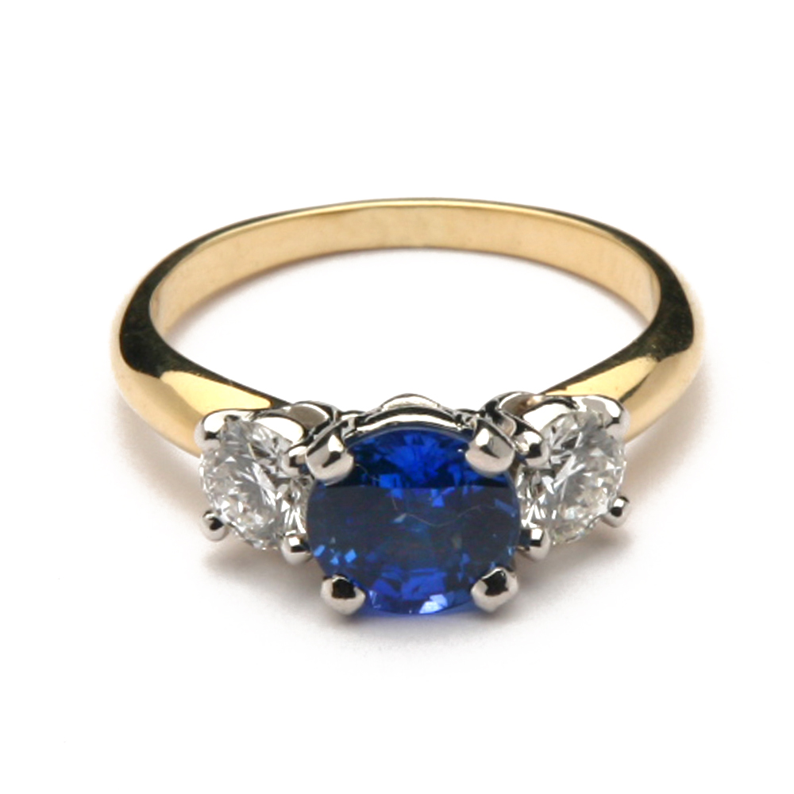
ᎨᏙ ᎢᏳᏍᏗ ᏓᏆᎿᏩ?
ᎠᎵᏰᏑᎳ

Slide 8
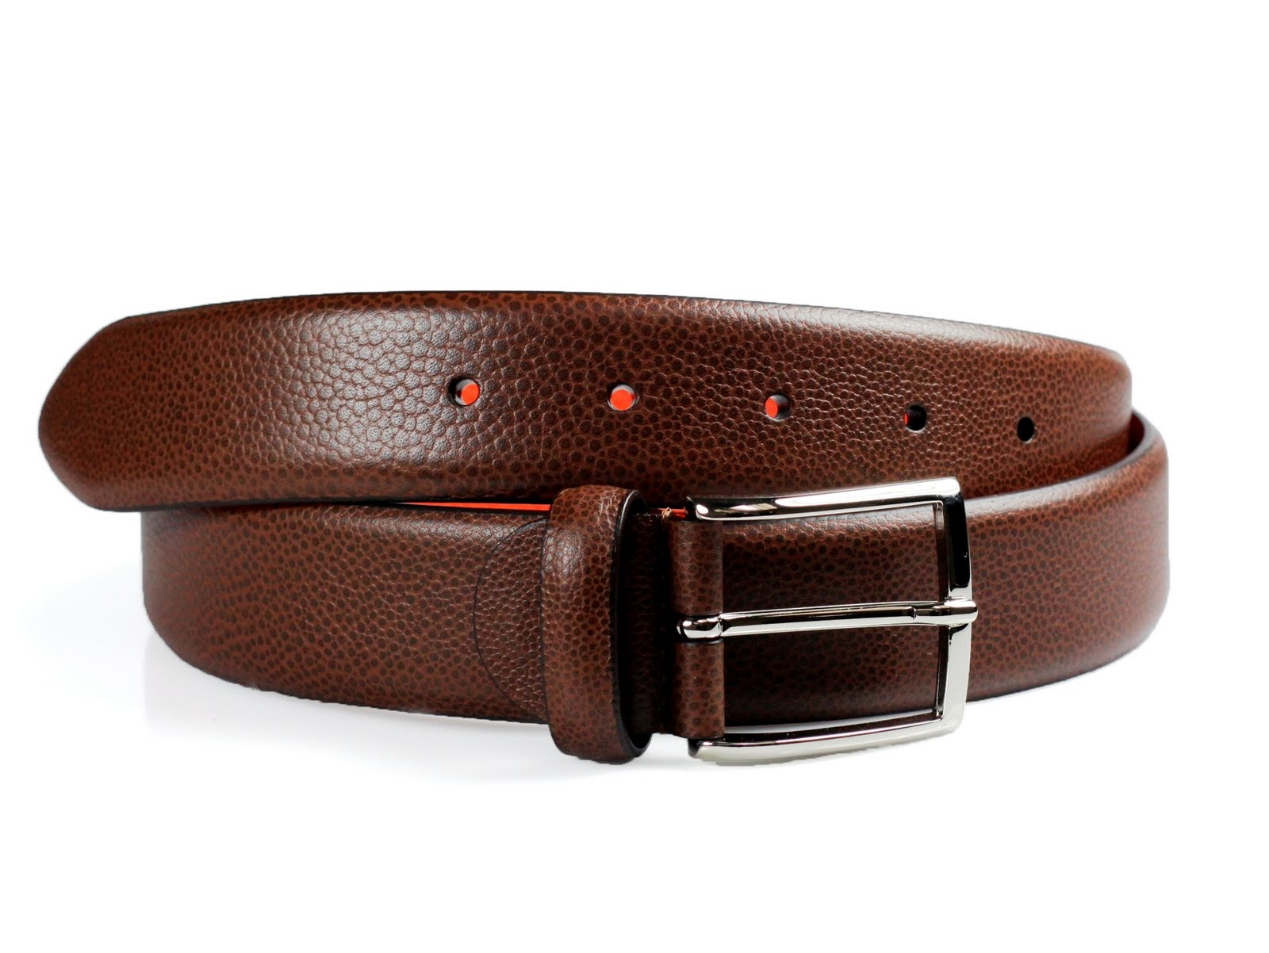
ᎨᏙ ᎢᏳᏍᏗ ᏓᏆᎿᏩ?
ᎠᏓᏦᏍᏗ

Slide 9
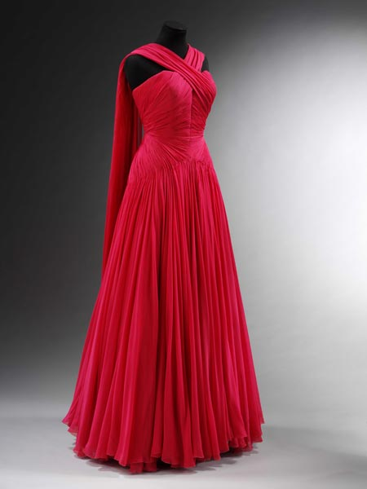
ᎨᏙ ᎢᏳᏍᏗ ᏧᏂᎿᏬ ᏄᏂᏓᎴ ᎠᏂᏴᏫ?
ᎤᎳᏍᎨᏗ ᎠᏌᏃ

Slide 10
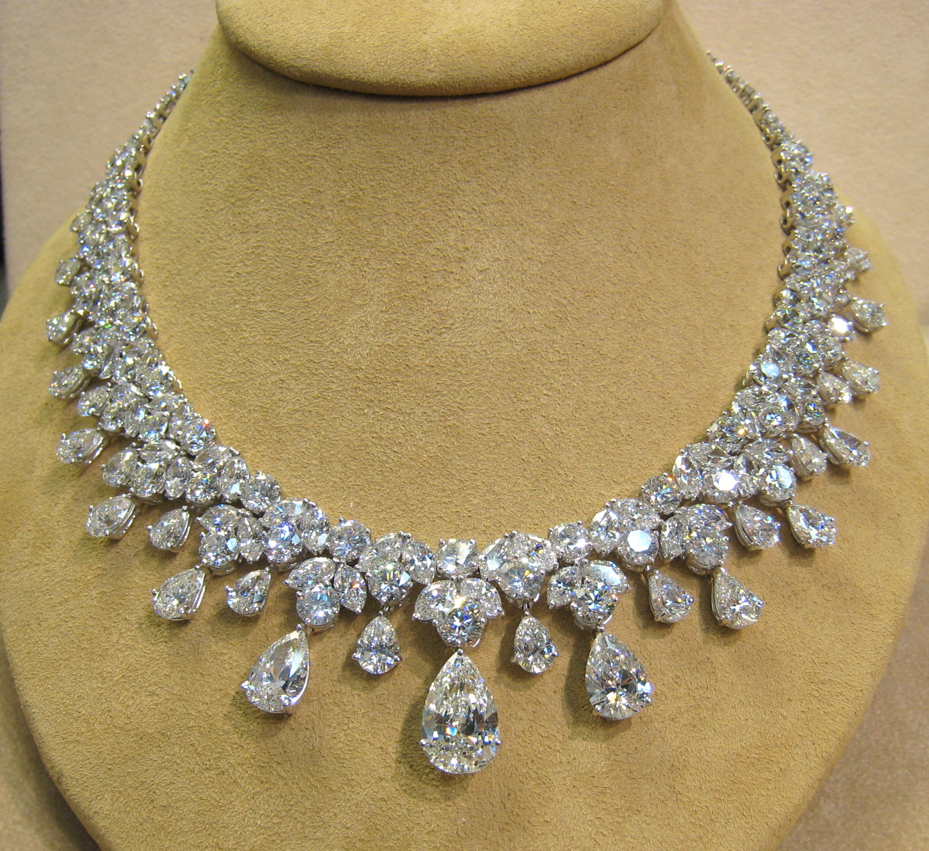
ᎨᏙ ᎢᏳᏍᏗ ᏄᏓᎴ?
ᎠᏴᏣᏗ
ᎢᏣᎾᏔᏍ “ᏗᎧᏁᏍᏗ ᎠᏴᏣᏓ”…?

Slide 11
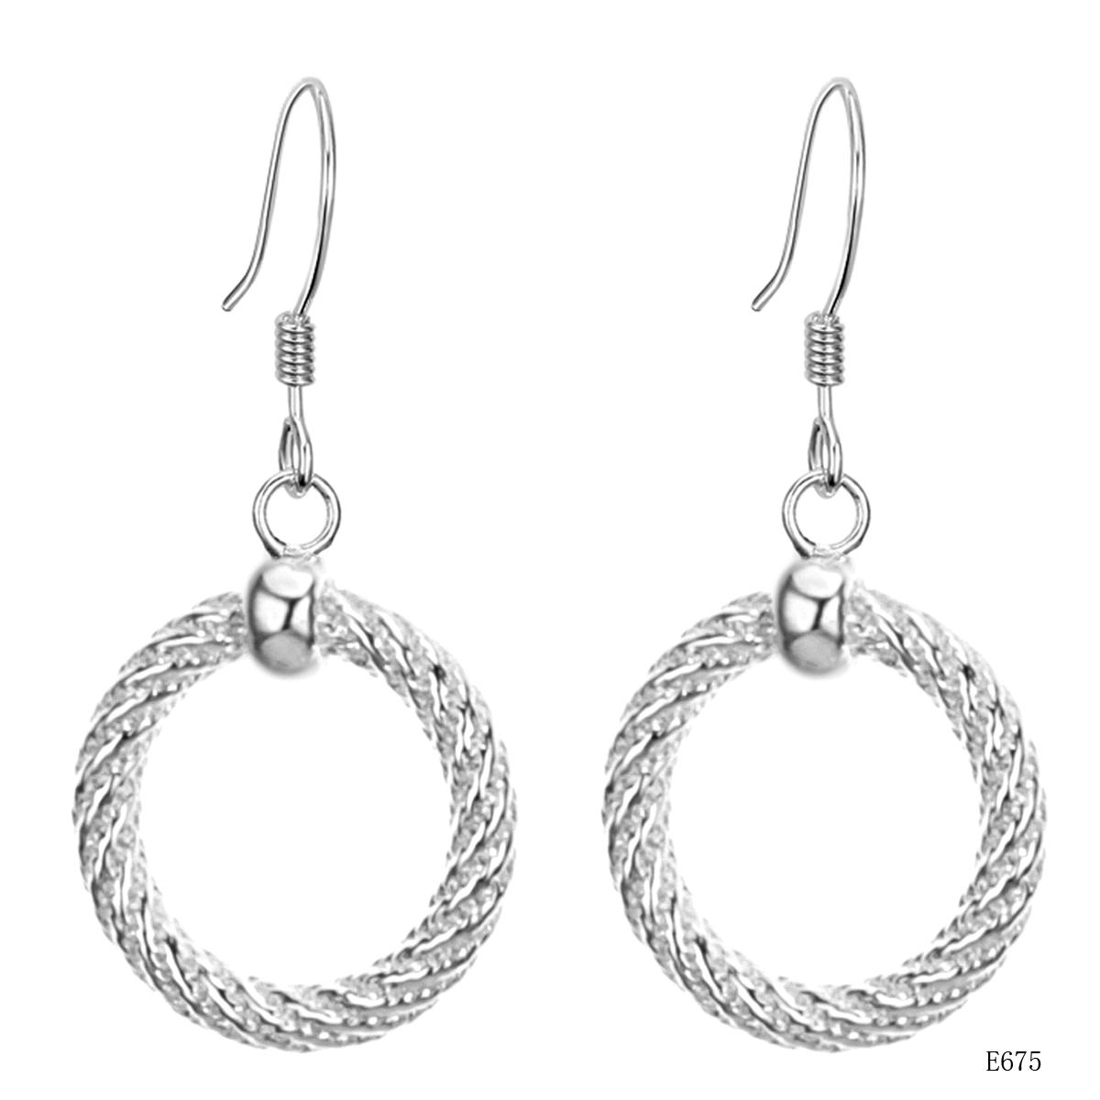
ᎨᏙ ᎢᏳᏍᏗ ᏧᏂᎿᏬ ᏄᏂᏓᎴ ᎠᏂᏴᏫ?
ᏗᎦᎴᏂ ᏗᎦᏛᏗ

Slide 12
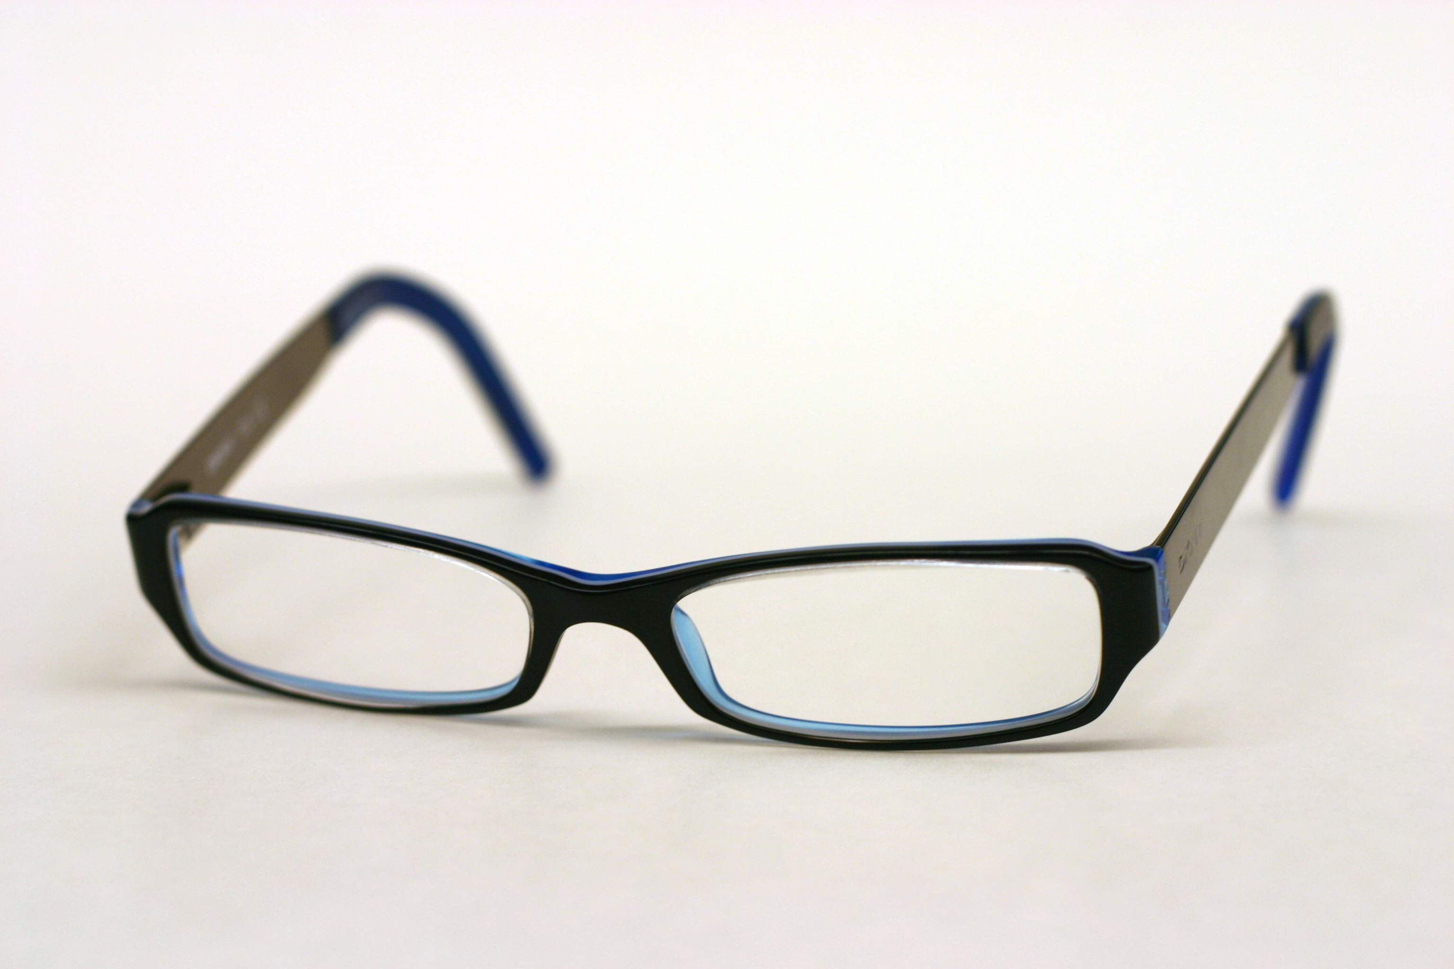
ᎨᏙ ᎢᏳᏍᏗ ᏧᏂᎿᏬ ᏄᎾᏓᎴ ᎠᏂᏴᏫ?
ᏗᎦᏘᏅᏓ

Slide 13
ᎨᏙ ᎢᏳᏍᏗ ᏧᏂᎾᏩ ᏕᏍᏓᎵᎢ?
3 ᎢᏯᏂ ᎠᏂᏴᏫ ᎠᎾᏛᏁᏍᎨᏍᏗ
ᏗᏣᏓᏔᏛᎲᎦ:
“ᎨᏙ ᎢᏳᏍᏗ ᏓᏆᎿᏩ?”
“ᎨᏙ ᎢᏳᏍᏗ ᏕᏣᎿᏩ?”
“ᎨᏙ ᎢᏳᏍᏗ ᏧᎿᏩ?”

Slide 14
ᎢᏥᎪᏩ.ᏛᏗ ᏗᎧᏁᎢᏍᏗ: (ᏗᏥᎪᎵᏰ!)
ᏄᏓᎴ

Slide 15
ᎢᏥᎪᏩ.ᏛᏗ ᏗᎧᏁᎢᏍᏗ: (ᏗᏥᎪᎵᏰ!)
ᏣᎾᏗᏍᎪᎢ

Slide 16
ᎢᏥᎪᏩ.ᏛᏗ ᏗᎧᏁᎢᏍᏗ: (ᏗᏥᎪᎵᏰ!)
ᎨᏙ ᎢᏳᏍᏗ

Slide 17
ᎢᏥᎪᏩ.ᏛᏗ ᏗᎧᏁᎢᏍᏗ: (ᏗᏥᎪᎵᏰ!)
ᎪᏪᎳᏅᎢ

Slide 18
ᎢᏥᎪᏩ.ᏛᏗ ᏗᎧᏁᎢᏍᏗ: (ᏗᏥᎪᎵᏰ!)
.ᎩᎶᎢ

Slide 19
ᎢᏥᎪᏩ.ᏛᏗ ᏗᎧᏁᎢᏍᏗ: (ᏗᏥᎪᎵᏰ!)
ᎠᏃᏎᎰᎢ

Slide 20
ᎢᏥᎪᏩ.ᏛᏗ ᏗᎧᏁᎢᏍᏗ: (ᏗᏥᎪᎵᏰ!)
ᎨᏍᏗ

Slide 21
ᎢᏥᎪᏩ.ᏛᏗ ᏗᎧᏁᎢᏍᏗ: (ᏗᏥᎪᎵᏰ!)
ᏧᎾᏕᎶᏆᏍᏗ

Slide 22
ᎢᏥᎪᏩ.ᏛᏗ ᏗᎧᏁᎢᏍᏗ: (ᏗᏥᎪᎵᏰ!)
ᏕᎾᏓᎪᎲᏳ

Slide 23
ᎢᏥᎪᏩ.ᏛᏗ ᏗᎧᏁᎢᏍᏗ: (ᏗᏥᎪᎵᏰ!)
ᎪᎱᏍᏗ

Slide 24
ᎢᏥᎪᏩ.ᏛᏗ ᏗᎧᏁᎢᏍᏗ: (ᏗᏥᎪᎵᏰ!)
ᎤᏍᏆᏂᎦᏘ

Slide 25
ᎢᏥᎪᏩ.ᏛᏗ ᏗᎧᏁᎢᏍᏗ: (ᏗᏥᎪᎵᏰ!)
ᏂᎪᎯᎸ

Slide 26
ᎢᏳᏕᏘᏴᏌᏗᏒ ᎧᏃᎩᏓ!
Paula Nelson ᎤᏬᏪᎳᏅᎢ ᏃᎴ ᎧᏃᎩᎠ
ᎪᎨᏱ
ᎪᎩ
ᎤᎳᎪᎲᏍᏗ…
ᎪᎳ …ᎪᎳ

Slide 27
ᎨᏙ ᎢᏳᏍᏗ ᎤᎿᏩ ᏕᏍᏓᎵᎢ?
Bill: “Ꭳ… Frank! ᎯᎠ ᎤᏬᏚᎯ ᏣᎿᏬ!”
Frank: “ᏍᎩ Bill! ᎣᏍᏓ ᎠᎩᏴᎸ ᎦᏌᎴᎾ ᏣᏤᎵ!”
Bill: “ᏩᏙ! ᎦᏨ ᏣᏩᏍᎨᎢ ᏣᎵᏍᏇᏔᏬ?”
Frank: “Belk Ꭰ.ᎩᏩᏍᎬᎢ Ꮎ. ᎤᏙᎯᏳ ᎤᎦᎿᏩ!”
ᎤᏬᏚᎯ – pretty / sharp
ᎣᏍᏓ ᎠᎩᏴᎸ – I find it good (I like it)
[Set B] –wasg__ = “buy”
ᏣᏤᎵ / ᎠᏆᏤᎵ – “yours/mine”
ᎠᏆᎿᏬ / ᏣᎵᏍᏇᏔᏬ = “my shirt” / “your hat” (Set B vs. “-atseli”)

