Slide 1
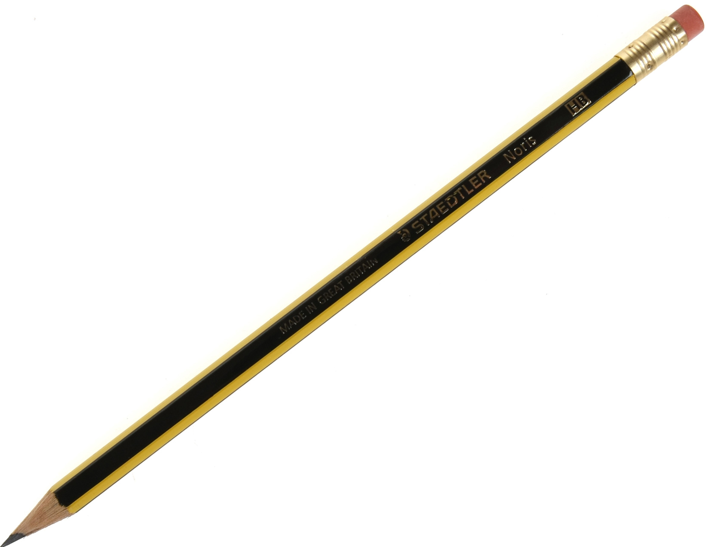
ᎲᎦ ᎢᎦ ᏗᎪᏪᎶᏙᏗ ᏕᎯᎪᏩᏘᎭ?
…1 ᏗᎪᏪᎶᏙᏗ ᏥᎪᏩᏘᎭ.
ᏗᎪᏪᎶᏙᏗ

Slide 2
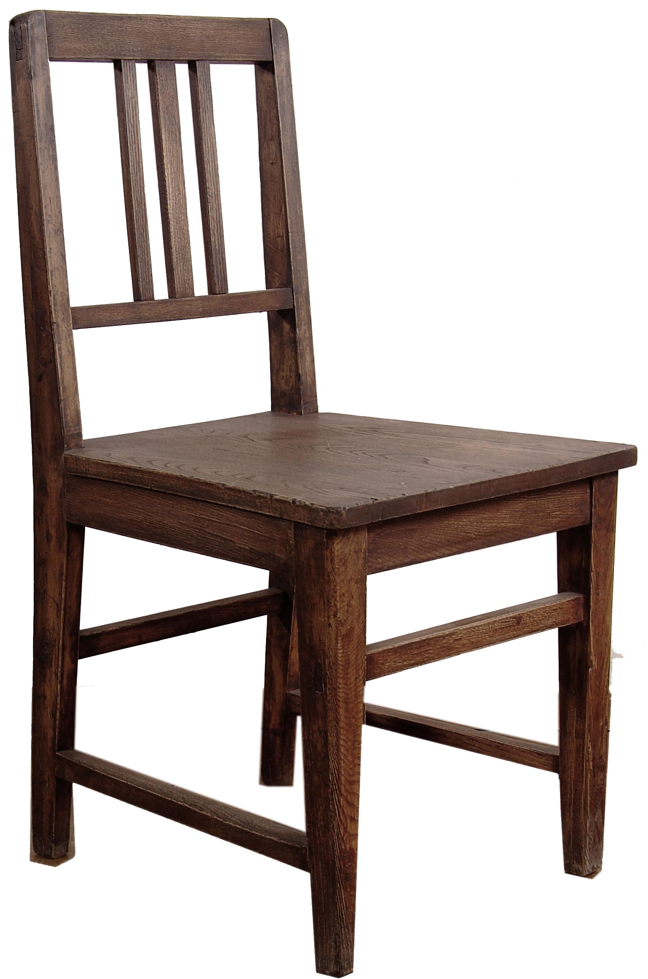
ᎦᏍᎩᎶᎢ

Slide 3
ᎲᎦ ᎢᎦ ᎦᏍᎩᎶᎢ ᎯᎠ?
3 ᎦᏍᎩᎶᎢ ᏕᏥᎪᏩᏘᎭ!
ᎲᎦ ᎢᎦ ᎯᎪᏩᏘᎭ?

Slide 4
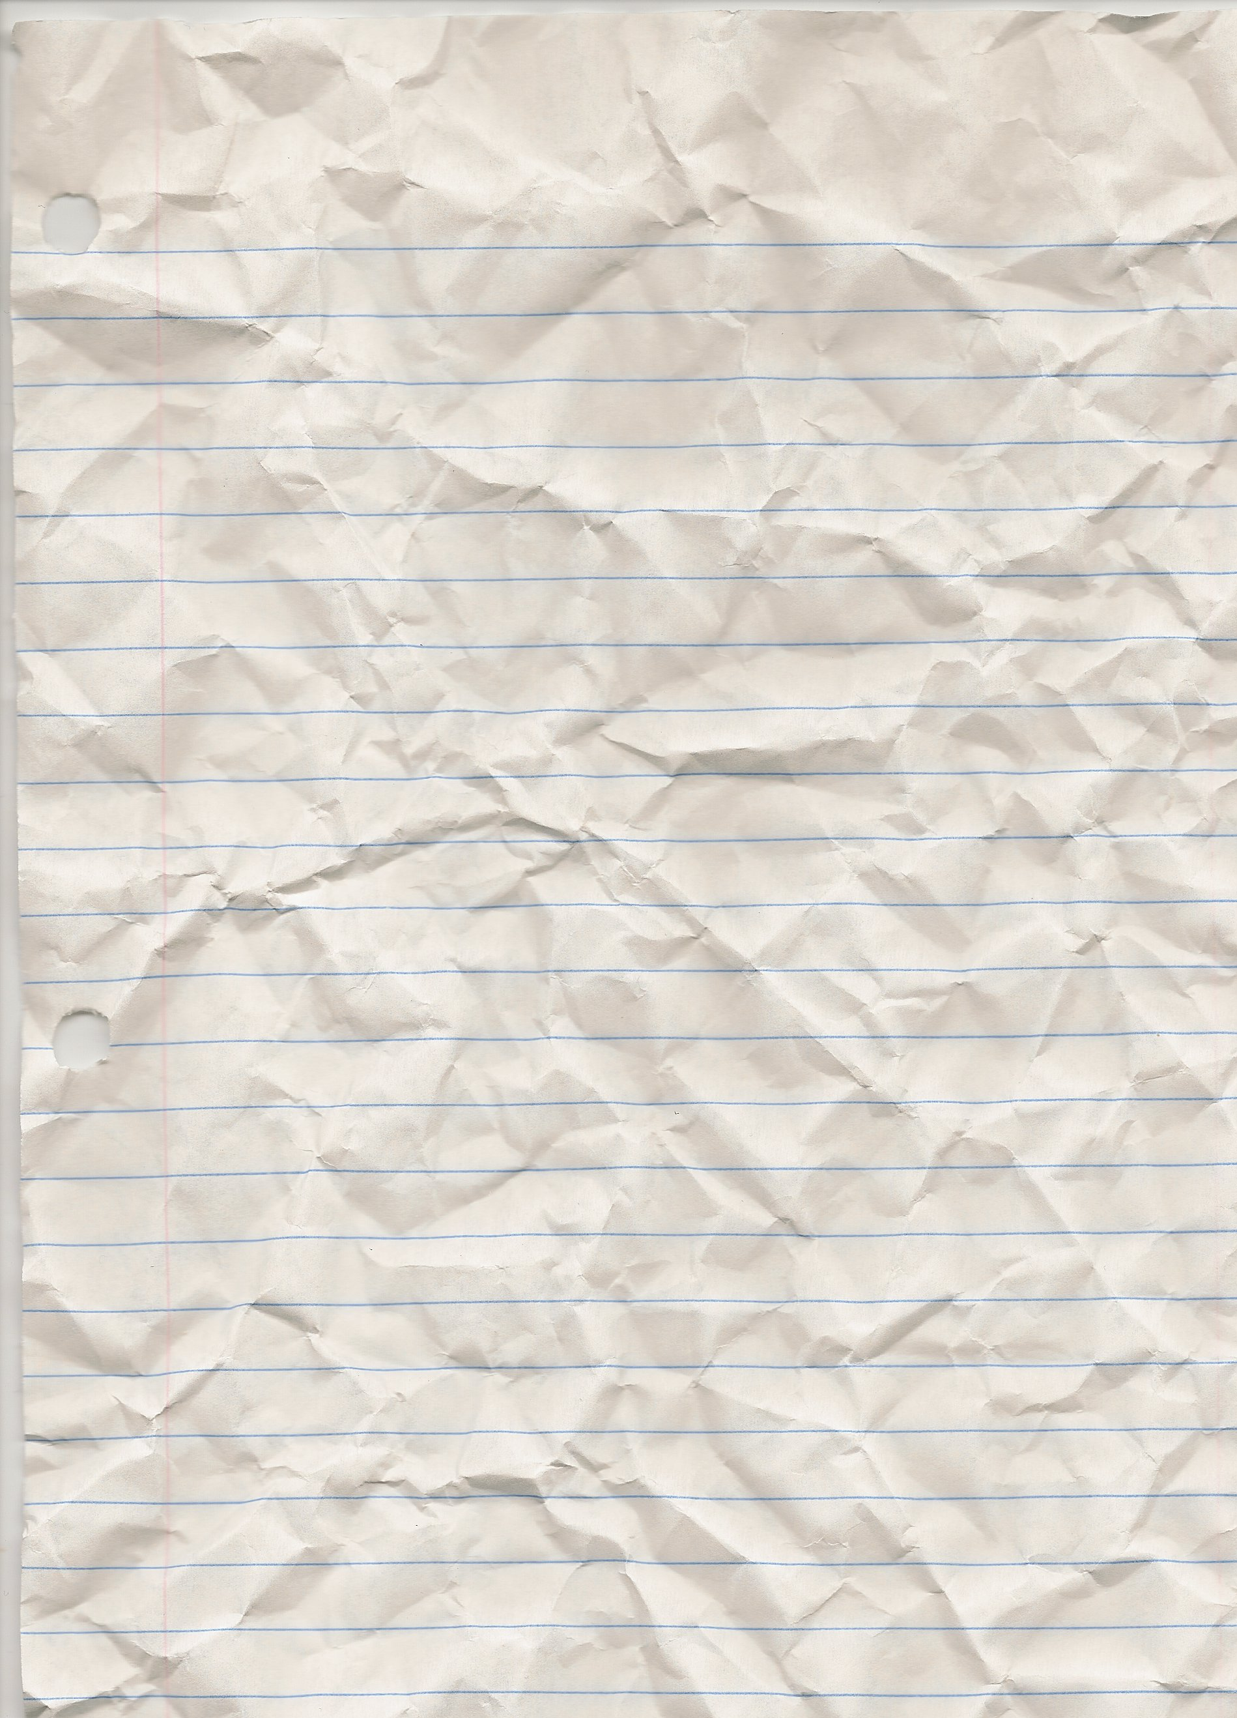
ᎪᏪᎵ

Slide 5
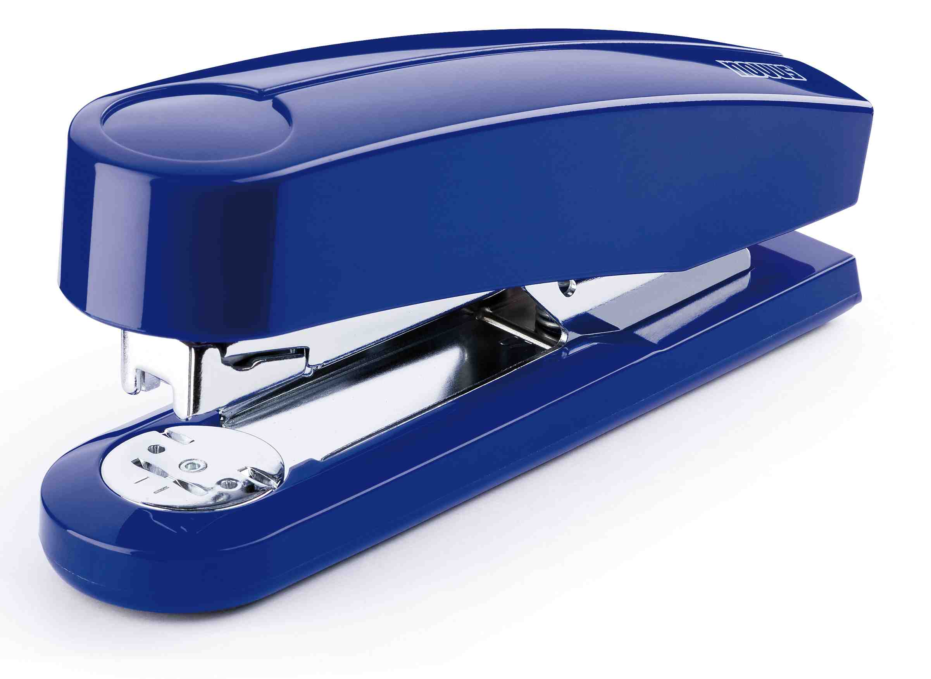
ᎪᏪᎵ ᏗᎧᏁᏍᏙᏗ

Slide 6
ᎪᏪᎵ ᏗᎧᏁᏍᏙᏗ ᎠᏆᏚᎵᎭ!

Slide 7
ᎲᎦ ᎢᎦ ᎪᏪᎵ ᏗᎧᏁᏍᏙᏗ ᏣᏚᎵᎭ?
2 ᏓᏆᏚᎵᎭ!

Slide 8
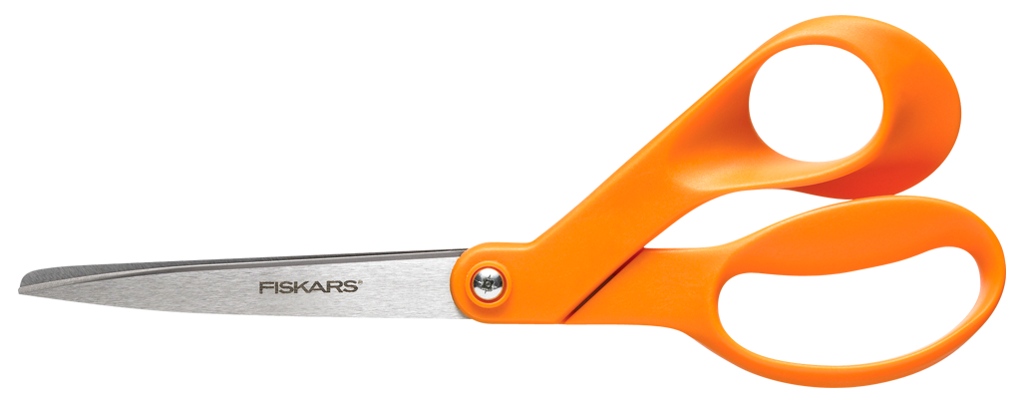
ᏗᎵᏍᏙᏗ

Slide 9
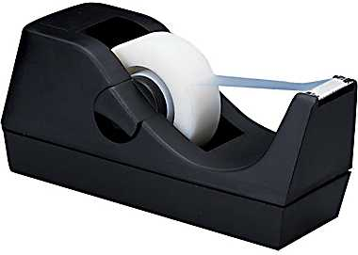
ᎦᏯᎸᏙᏗ

Slide 10
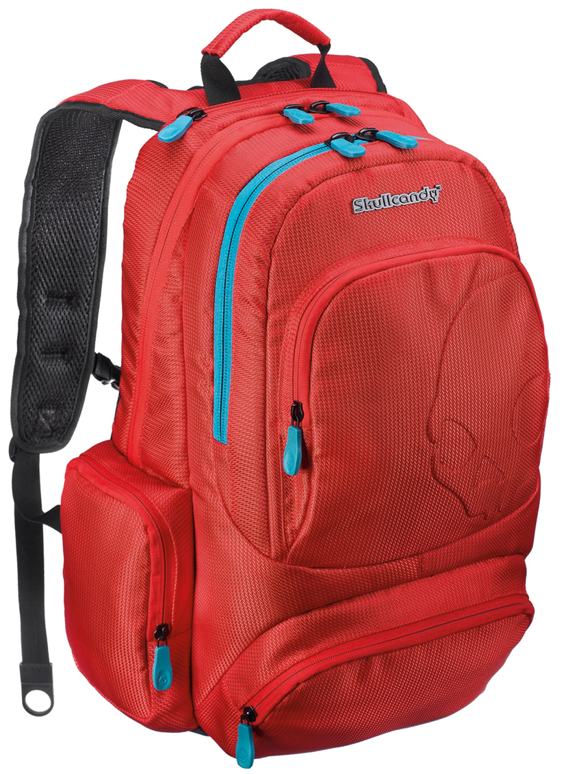
ᏕᎦᏝᏗ

Slide 11
ᎢᏣᏓᏔᏛᎲᎦ!
ᎲᎦ ᎢᎦ ________ ᎯᎠ?
ᎲᎦ ᎢᎦ ________ ᎯᎪᏩᏘᎭ? ______ (Ꮥ)ᏥᎪᏩᏘᎭ
ᎲᎦ ᎢᎦ ________ ᏣᏚᎵᎭ? ______ (Ꮣ/Ꭰ)ᏆᏚᎵᎭ

Slide 12
ᏗᏤᏅᏒ ᏕᏣᎸᏫᏍᏓᏁᏗ
ᎭᎦᏎᏍᏓ: ᏗᎪᏪᎵ 10-11
REVIEW – 6 week exam on Friday
Keep in mind – We will conduct oral exams by appointment next week.

