Slide 1
ᎦᏨ?
CHER 203

Slide 2

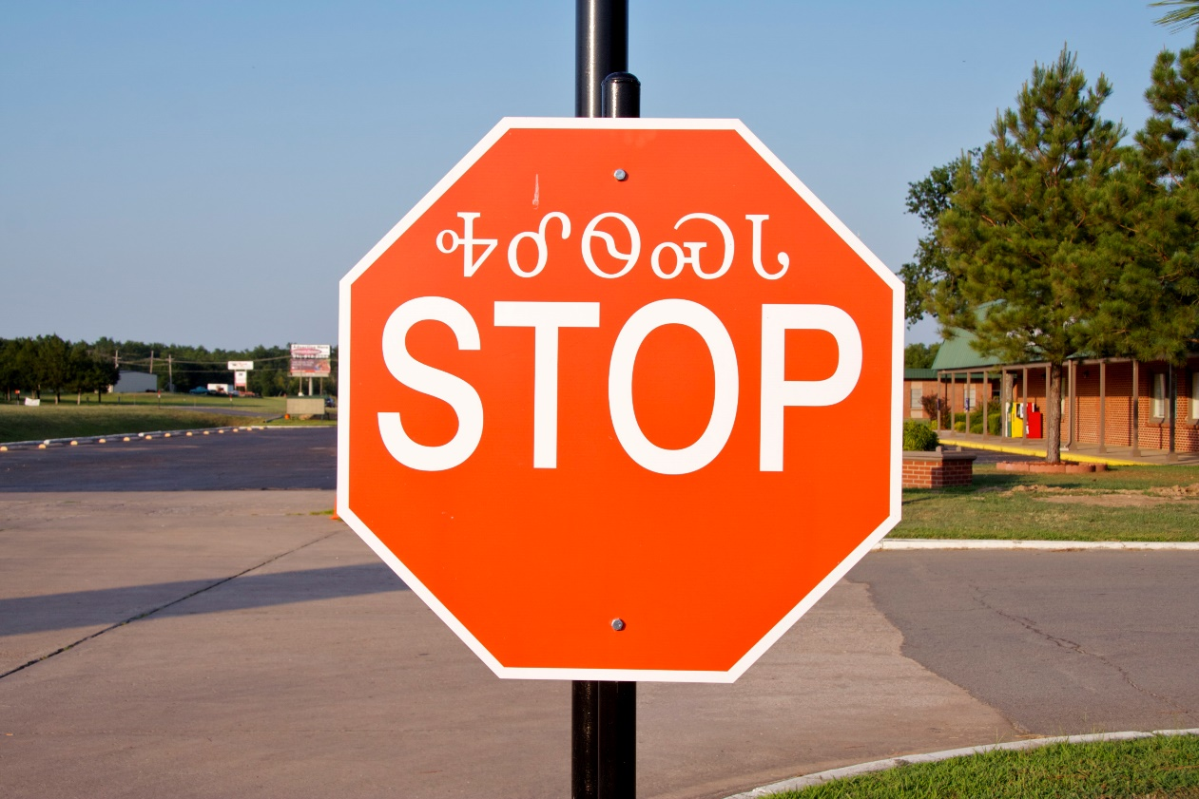
ᎭᎴᏫᏍᏓ

Slide 3

ᎠᎩᏍᎦᎾ

Slide 4

ᎠᎧᏘᏏ

Slide 5

ᎠᎦᏔᎲᏒ

Slide 6

ᏗᎪᏪᎵ ᎠᏍᏆᏂᎪᏙᏗ

Slide 7

ᎧᏫ ᎠᏓᎾᏅ

