Slide 1
ᏣᎳᎩ 101
Family & Clan Kinship

Slide 2
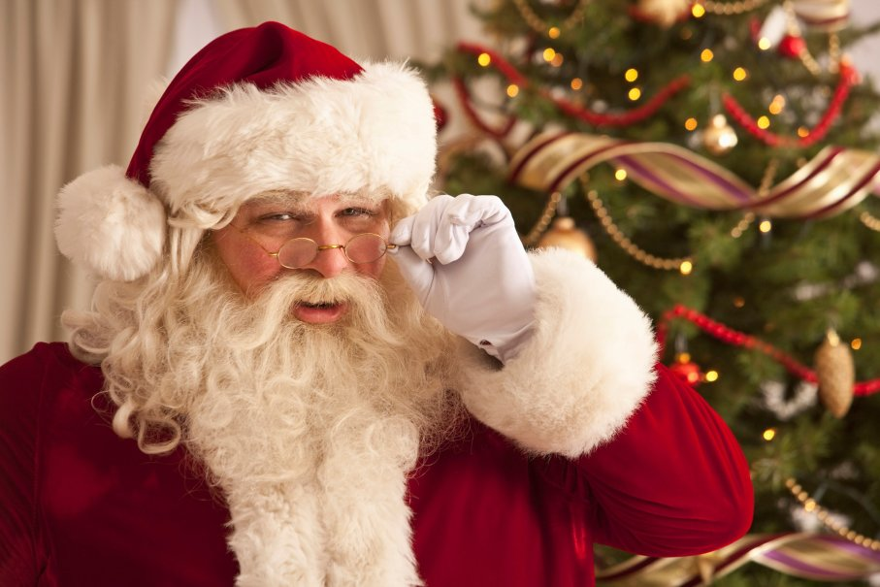
Kago iyusdi hi’a?
Gedo iyusdi dudo’a?
Gatsv ganela?
Idalsinahvsdisgesdi!

Slide 3
Smith sidanelv
Will
Jada Pinkett
Jaden
Willow
Gedo iyusdi dudo’a Jaden utsi?
Gedo iyusdi dudo’a Willow udoda?
Gedo iyusdi dudo’a udohi Willow?
Kago iyusdi Jaden udohi?

Slide 4
Find out!
That person across the room…
What is their name?
Where are they from?
Where do they live?
Who are their parents?

Slide 5
Itsitvgi!

Slide 6
Cherokee Clans
7 matrilineal clans
Aniwaya – Wolf
Anisahoni – Blue
Anigilohi – Long Hair
Aniwodi – Paint
Anitsisgwa – Bird
Anikawi – Deer
Anigodigewi – Wild Potato
“Anikawi digiyvwi”
“Anisahoni digilstali”
“Aniwaya agwalstalv”

Slide 7
Itsitvgi!

Slide 8
Clans
“Gedo usdi ditsayvwi?”
“Aniwodi digiyvwi”
“Gedo usdi ditsalstali?”
“Anikawi digilstali”
“Gedo usdi tsalstahlv?”
“Anigodigewi agwalstahlv.”

Slide 9
Cherokee Townships
Yellowhill - Elawodi
Birdtown - Tsisgwohi
Wolftown – Wayohi
Big Cove – Kolanvyi
Painttown – Aniwodi
Snowbird - Tutiyi

Slide 10
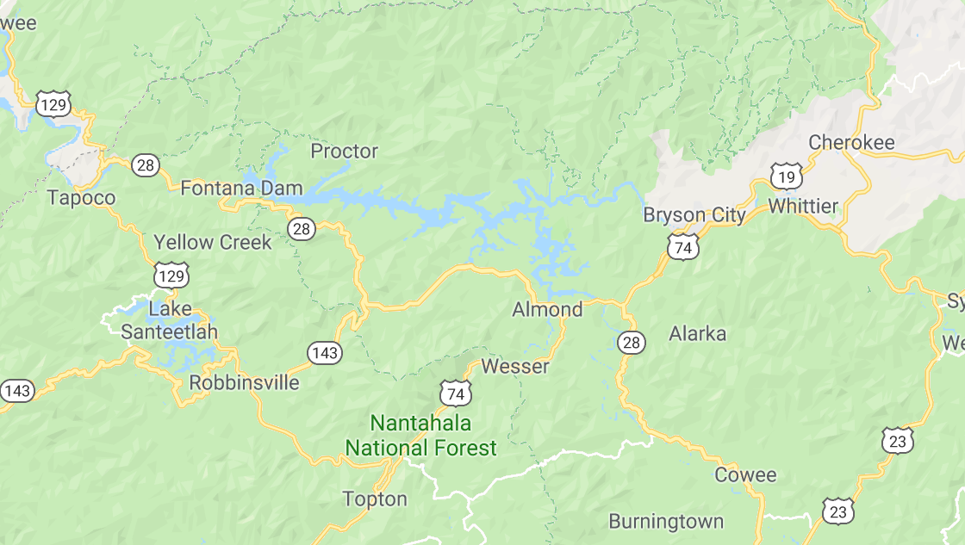
Townships
Big Cove
Yellow Hill
Paint Town
Bird Town
Wolf Town
Snowbird

