Slide 1
ᏣᎳᎩ 101
Feelings & Grammar

Slide 2

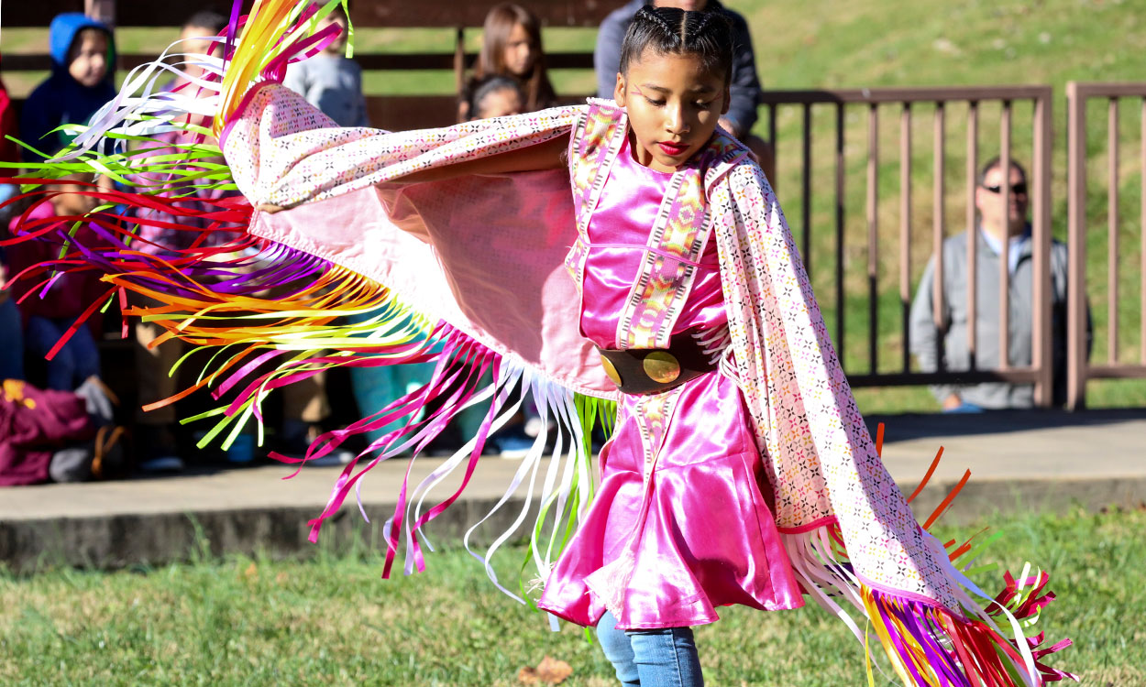
Didinogi! Ulihelisdi iga
Ulihelisdi iga
Diniyotli
Tsalagi idiwonisgesdi
Itsudetiyvda alihelisdi
Nole tsatseli ayetsasdi
Tsalagi didinogisgesdi
Nigada idaheliga
didadanugitsada

Slide 3

Gedogwu udanti?
1) galvsga
2) duyawega
3) uyosiha
4) utadegi’a

Slide 4
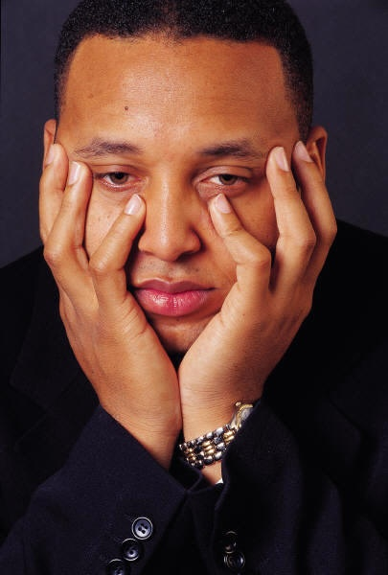
Gedogwu udanti?
1) osda udanti
2) uyo’i udanti
3) utadegi’a
4) uyosiha

Slide 5
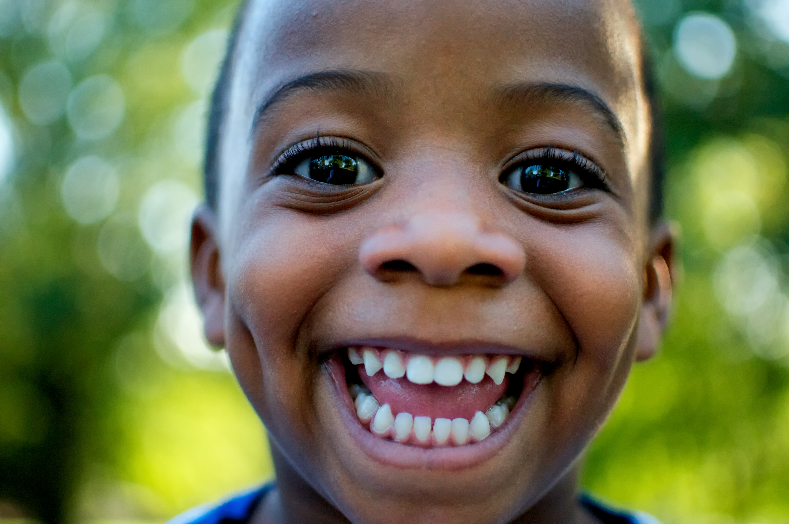
Gedogwu udanti?
1) uyo’i udanti
2) uyosiha
3) galvsga
4) aliheliga

Slide 6

Gedogwu tsadanti?
Gali’eliga haliheligatsu?
Tsilvsga hilvsgatsu?
Agiyosiha tsayosihatsu?
Agwatadegi’a tsatadegi’atsu?
Uyo’i agwadanti uyo’itsu tsadanti?
dagiyawega detsayawegatsu?

Slide 7
Conjugation
I: Agw- adanati
You: ____
(s)he: ___
I: agi- yosiha
You: ___
(s)he: __
I: tsi- lvsga
You: hi- lvsga
(s)he: ga- lvsga
I: g- aliheliga
You: h- aliheliga
(s)he: __- aliheliga

Slide 8
Verb Sets
Set B:
agi- / agw-
ts(a)-
u-
Set A:
tsi- / g-
h(i)-
__- / g-

Slide 9

Gedogwu tsadanti?
Each person has a picture. When your partner asks you “gedogwu tsadanti?” Give the appropriate answer based on the picture you have
  Ex: Picture - ☺
  A: Siyo! Gedogwu tsadanti?
  B: gali’eliga! Nihina? Gedogwu tsadanti?

Slide 10
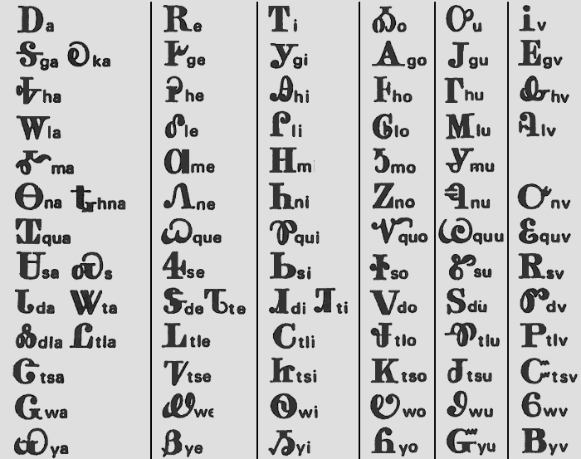
Cherokee Syllabary – How it works
Cross-referenceable
a e i o u v
G/K Ꭶ
H
L
M Ꮌ
…

Slide 11
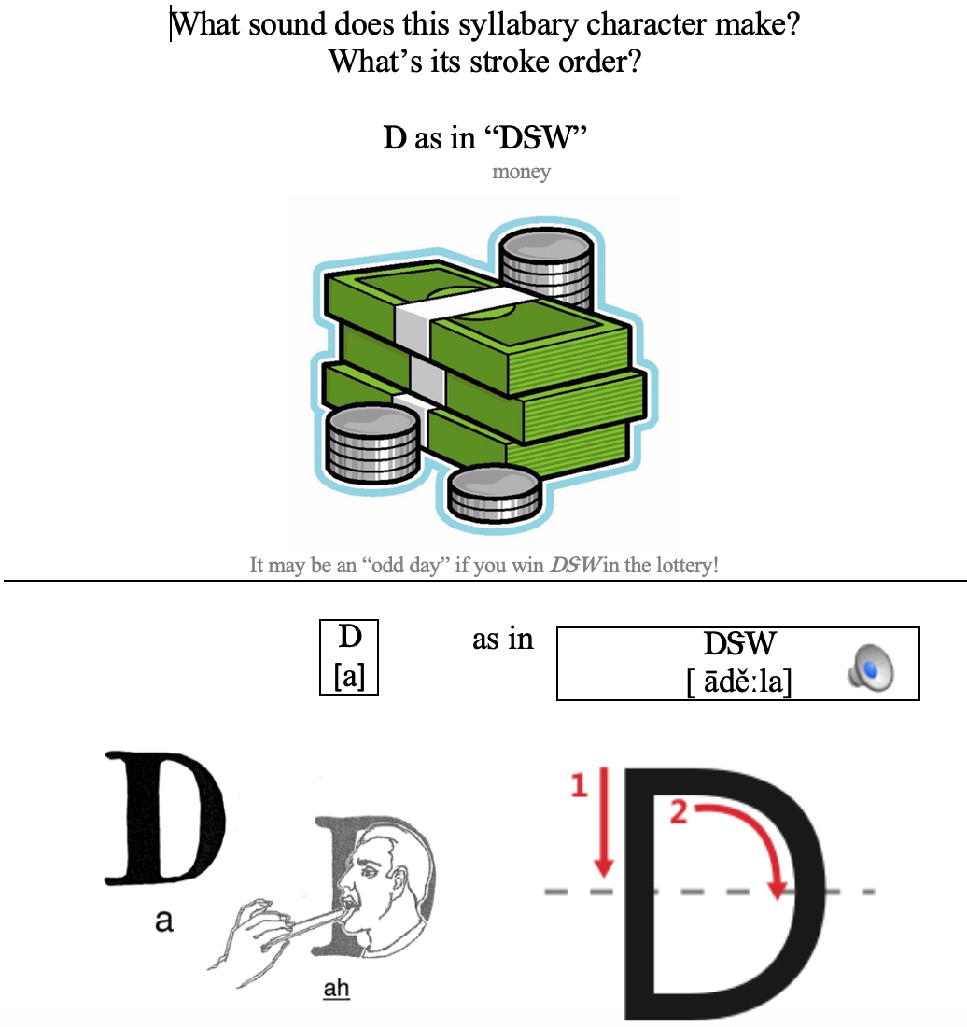
Learning Syllabary
Mnemonic devices are your friend
Test yourself lots of different ways (see Wyner’s Fluent Forever)
Learn whole words, names – then you’ll know lots of characters at once! (ᏣᎳᎩ, ᏏᏲ, ᎣᏏᏉᏧ...)

Slide 12
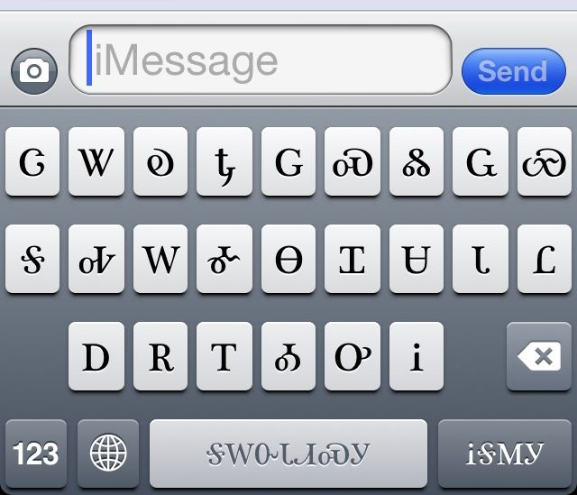
Syllabary on Devices
Cherokee QWERTY or other phonetics-based keyboard (?)
  Use caps lock to type in phonetics ➔ syllabary
  Sx ➔ Ꮝ, ra ➔ Ꮭ, qa ➔ Ꮖ
  Za ➔ Ꮳ, hb ➔ Ꮏ
Texting – type Ꮳ (tsa) and Ꭱ (e) and the Ꮴ (tse) character appears

Slide 13
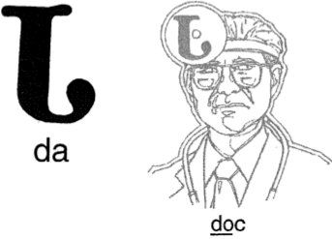
Syllabary Quizzes
For your first quiz, you will be responsible for:
Ꭰ, Ꭳ, Ꮟ, Ᏺ, Ꭺ, Ꮙ, Ꮖ,
Ꮣ, Ꮩ, Ꮃ, Ꮥ, Ꮕ, Ꮳ, Ꮷ

