Slide 1
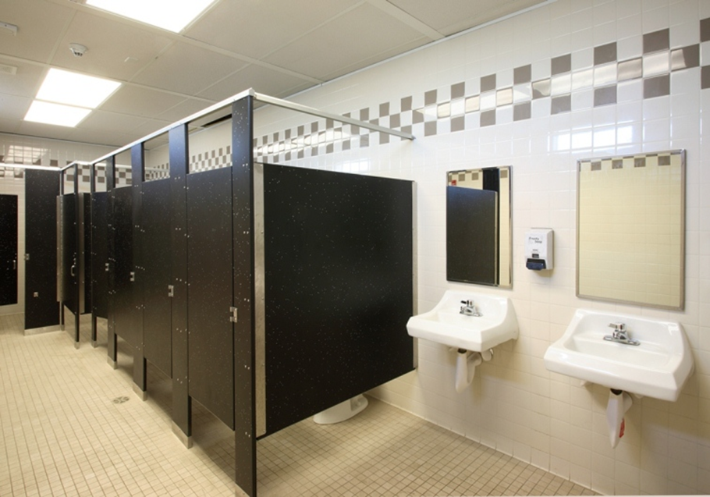
ᎤᎾᏨᏍᏗ
(ᎦᏨ ᏫᎦᏘ? – “ᎤᎾᏨᏍᏗ ᏫᏥᎦᏘ!”)

Slide 2

ᏗᏗᏂᎸᏌᏓᏗᏍᏗᏍᎬ

Slide 3
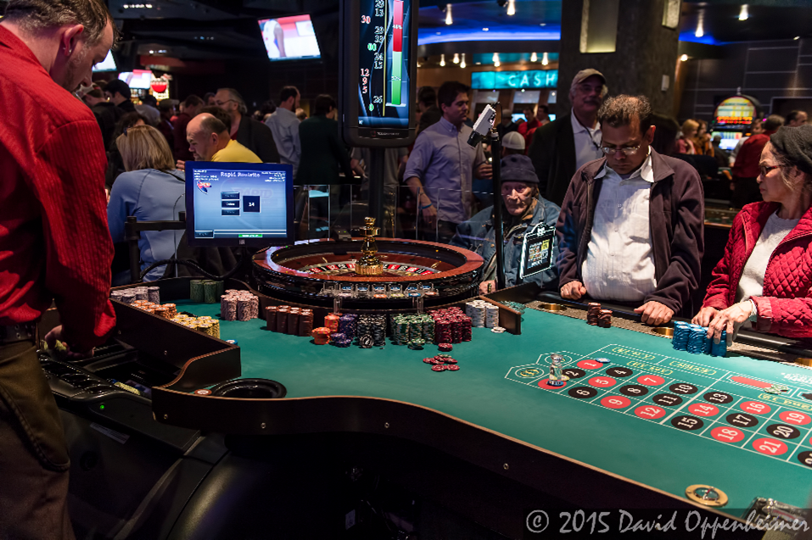
ᏧᏂᎾᏆᏂᏲᏍᏗ

Slide 4
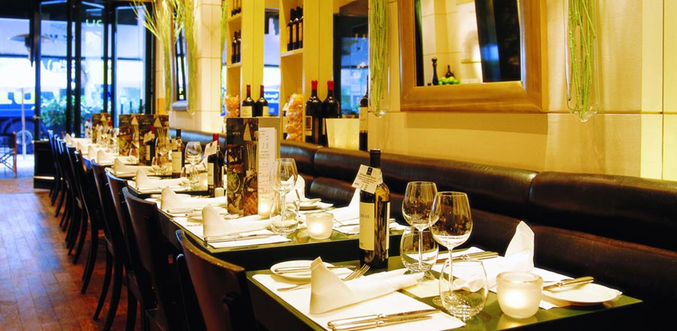
ᏧᎾᎵᏍᏓᏴᏗ

Slide 5
ᏗᏓᏁᎸ - ᎦᏨ ᏫᎦᏘ? ᎦᏨ ᏖᏏ?
ᎧᏫ ᎠᏓᎾᏅ
ᏗᏗᏂᎸᏌᏓᏗᏍᏗᏍᎬ
ᎤᎾᏨᏍᏗ
ᏧᏪᏅᏒ (/ᏗᏇᏅᏒ / ᏗᏤᏅᏒ)
ᏗᎪᏪᎵ ᎠᏓᎾᏅ
ᎠᎺᏉ
ᏧᏂᎾᏆᏂᏲᏍᏗ
ᏧᎾᎵᏍᏓᏴᏗ

Slide 6
ᏫᏥᎦᏘ - ᏓᎨᏏ
wi- tsi- -gati da- g – esi
wi- hi- -gati da- h – esi
wi- a- -gati da- a - esi

Slide 7
“ᏫᏥᎦᏘᎭ”
Ꮻ- toward something/at a distance/away from speaker
ᏫᏥᎦᏘᎭ
ᎯᏫᎦᏘᎭ
ᏩᎦᏘᎭ
  wi – [prefix] – [stem]
  Why “hwikti” for 2nd person singular?
  Travelin’ H!

Slide 8
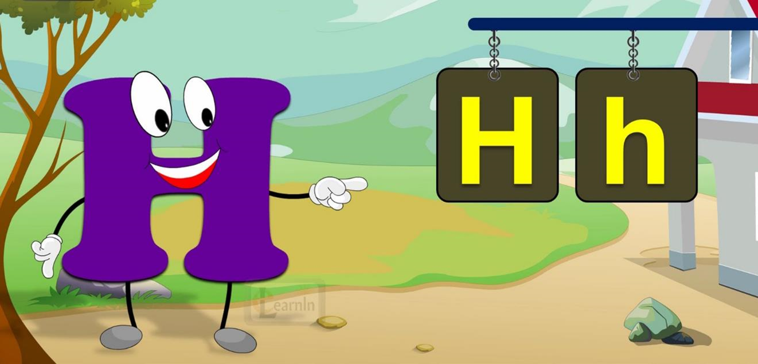
Travelin’ H (That ramblin’ letter…)

Slide 9
ᎭᏁᎵᏓ!
wi – hi –gatiha ➔ ___________
de – hi- utagi ➔___________
de – hi- hnogi ➔___________
ga – hnawoga ➔___________

Slide 10
ᎭᏁᎵᏓ!
wi – hi –gatiha ➔ hwigatiha
de – hi- utagi ➔tutagi
de – hi- hnogi ➔tinogi
ga – hnawoga ➔kanawoga

Slide 11
ᏗᏤᏅᏒ ᏕᏣᎸᏫᏍᏓᏁᏗ
5 Sentences about what you DID over the weekend – Remember! Use past tense suffix “v’i” – unless you don’t remember it; then use “e’i.” ;-)

