Slide 1
ᏣᎳᎩ 101
Greetings and Introductions

Slide 2
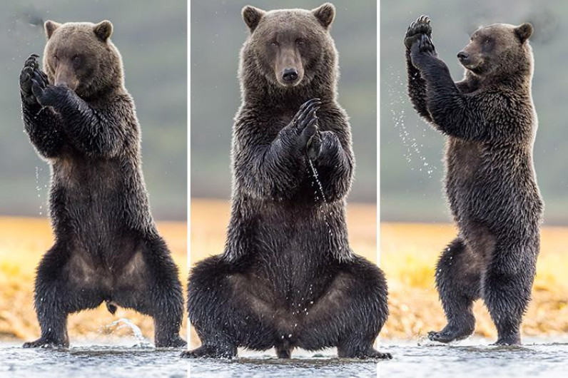
Yona yoga!
Galvnditsa!
Eladitsa!
Ohniditsa!
Agvyiditsa!

Slide 3

Counting the beat
Words have moras/”beats”
Not necessarily a syllable
How many “beats” is each word?
Practice sight-reading with a partner
Decide how many beats each word (1-5) is.
Reporter is the last person to have been in the Undergrad Library.

Slide 4
Frank nole Ritchie danadanohiseho’i dunado’v’i

Slide 5
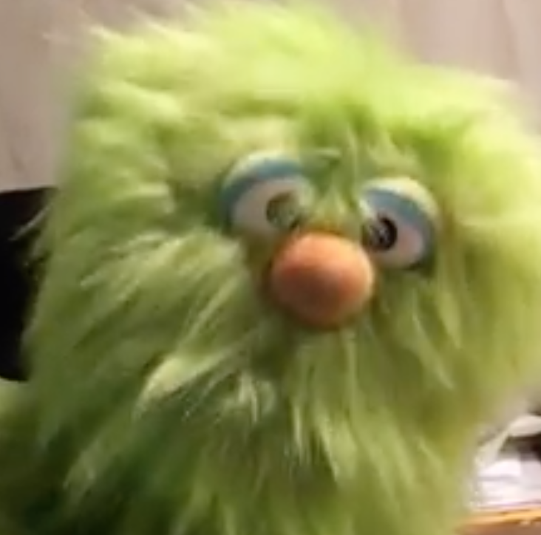
Gedo iyusdi dudo’a hi’a?
A) Uwenvhi
B) Ritchie
C) Elodi
D) Frank

Slide 6
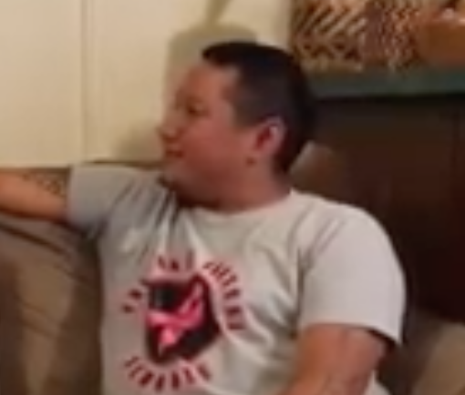
Gedo iyusdi dudo’a hi’a?
A) Ritchie/Uwenvhi
B) Uguku
C) Frank
D) Tohisgi

Slide 7
Frank nole Ritchie danadanohiseho’i dunado’v’i

Slide 8
Long forms vs. short forms
“gedo iyusdi detsado’a?” ➔
“gedo iyusdi tsanadisgo’i” ➔
“osigwo” ➔
“gesdi yitsigata” ➔
“hadi gohusdi” ➔
“do detsado?”
“doyusd tsandisgo?”
“osigw”
“ge yitsigat”
“di gohusd”

Slide 9
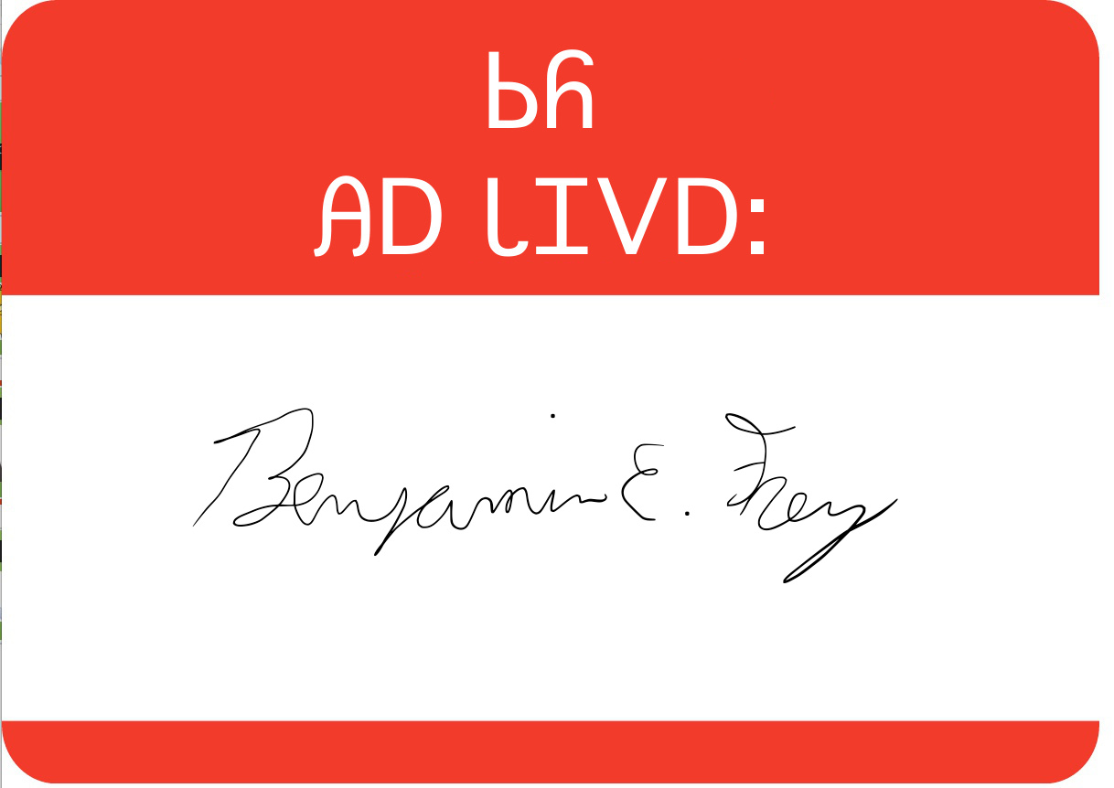
______ dagwado’a!
“Siyo! Do detsado?”
“____ dagwado! Nihina?”
“____ dagwado! Gali’eliga tsidenadohlgi!”
“Ayvsgwu gali’eliga tsidenadohlgi!”

Slide 10
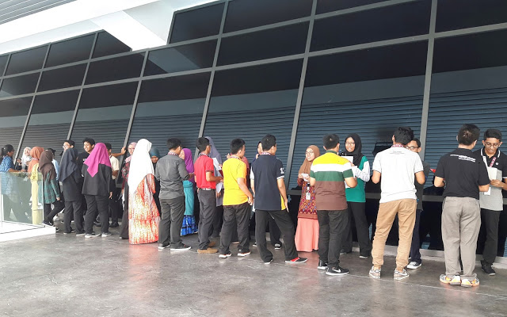
Introductions: “speed dating”
2 lines
  A: “Siyo, osigwotsu?”
  B: “osigwu, nihina?”
  A: “osda. Do detsado?”
  B: “____ dagwado, nihina?”
  A: “____ dagwado. Gali’eliga tsidenadohlgi!”
  “Ayvsgwu! Hawa, denadagohvyu!”
Shift 1 person right, A➔B

Slide 11

Dagwado’a – detsado’a – dudo’a
de agw ado’a➔ dagwado’a
de tsa ado’a➔ detsado’a
de u ado’a➔ dudo’a
de agi lvwisdaneha ➔ ?
de tsa lvwisdaneha ➔ ?
de u lvwisdaneha ➔ ?

Slide 12

Exercise - write out the conjugations yourself, check with a partner
1. agw aduliha (“want”)
  tsa aduliha
  u aduliha
2. agi yosiha (“be hungry”)
  tsa yosiha
  u yisiha
3. agw adanula (“be lazy”)
  tsa adanula
  u adanula

Slide 13
Gatsv daninela?
Write in the missing words!
Compare with a partner.

