Slide 1
ᏣᎳᎩ 101
Home and where you live

Slide 2

Grammar Face-off!
I need 2 teams!
Come to the board in pairs
I will give you the 1st person singular of a verb – write the 2nd and 3rd person forms!

Slide 3

Exercise - write out the conjugations yourself, check with a partner
1. agwaduliha (“want”)
  tsaduliha
  uduliha
2. agiyosiha (“be hungry”)
  tsayosiha
  uyosiha
3. agwadanula (“be lazy”)
  tsadanula
  udanula

Slide 4
Gatsv daninela?
Write in the missing words!
Compare with a partner.

Slide 5
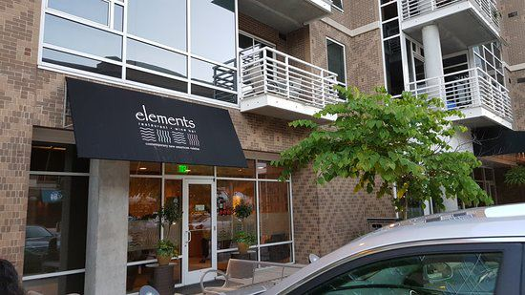
Hani tsinela!
Chapel Hill tsinela!
2203 Environ Way tsinela; nihina?
Gatsv hinela?

Slide 6


Gatsv tsatvsv?
Birmingham, AL agwatvsv.
Gatsv tsatvsv?

Slide 7
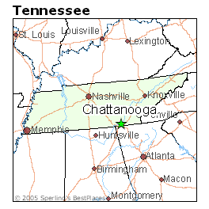
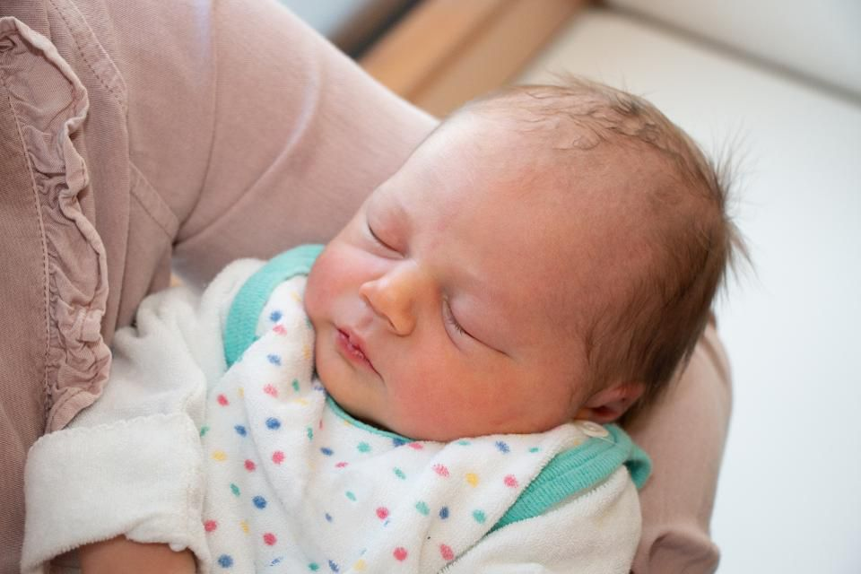
Chattanooga, TN agwadenv – gatsv tsadenv?

