Slide 1
ᏣᎳᎩ 101
Months, Days of the week

Slide 2
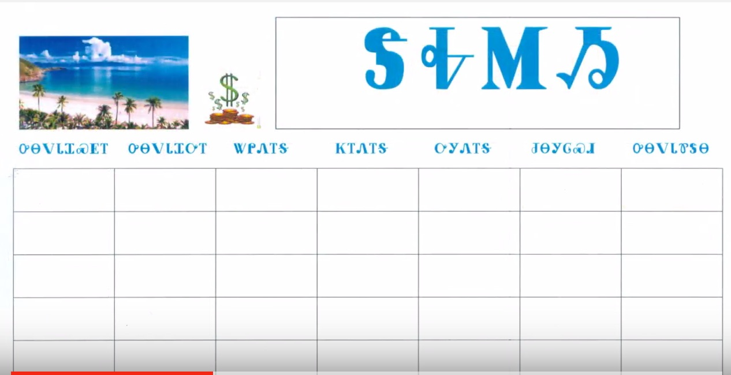

ᏅᏙ ᏗᏎᏍᏗ

Slide 3
ᎲᎦ ᏣᏕᏘᏴᏓ?
ᎲᎦ ᏣᏕᏘᏴᏓ?
33 ᎠᏆᏕᏘᏴᏓ.
5 ᎢᏯᏂ ᎠᏂᏴᏫ ᏗᏥ°ᏛᏛᎲᎦ - “ᎲᎦ ᏣᏕᏘᏴᏓ?”

Slide 4
ᎯᎳᎢᏳ ᏣᏘᏱᏍᎬ?
ᎨᏙ ᎤᏍᏗ ᏏᏅᏙ ᏣᏕᏘᏱᏍᎬ?
15^{ᏏᏁ} ᎫᏰᏉᏂ ᎠᏆᏕᏘᏱᏍᎬ.
15^{ᏏᏁ} ᎫᏰᏉᏂ, 1983 (ᏐᏁᎳᏚ ᏣᏁᎳᏍᎪ ᏦᎢ) ᎠᏆᏕᏅᎢ.
  5 ᎢᏯᏂ ᎠᏂᏴᏫ ᏗᏥ°ᏛᏛᎲᎦ!

Slide 5
Digohweli agsesdodi!

