Slide 1
ᏣᎳᎩ 101
Introducing Family

Slide 2


Itsadayolila! (5 ppl)
Greetings, feelings (use a different one for each person)
Introductions – yourself and one other person
Where you from?

Slide 3

Listening!

Slide 4
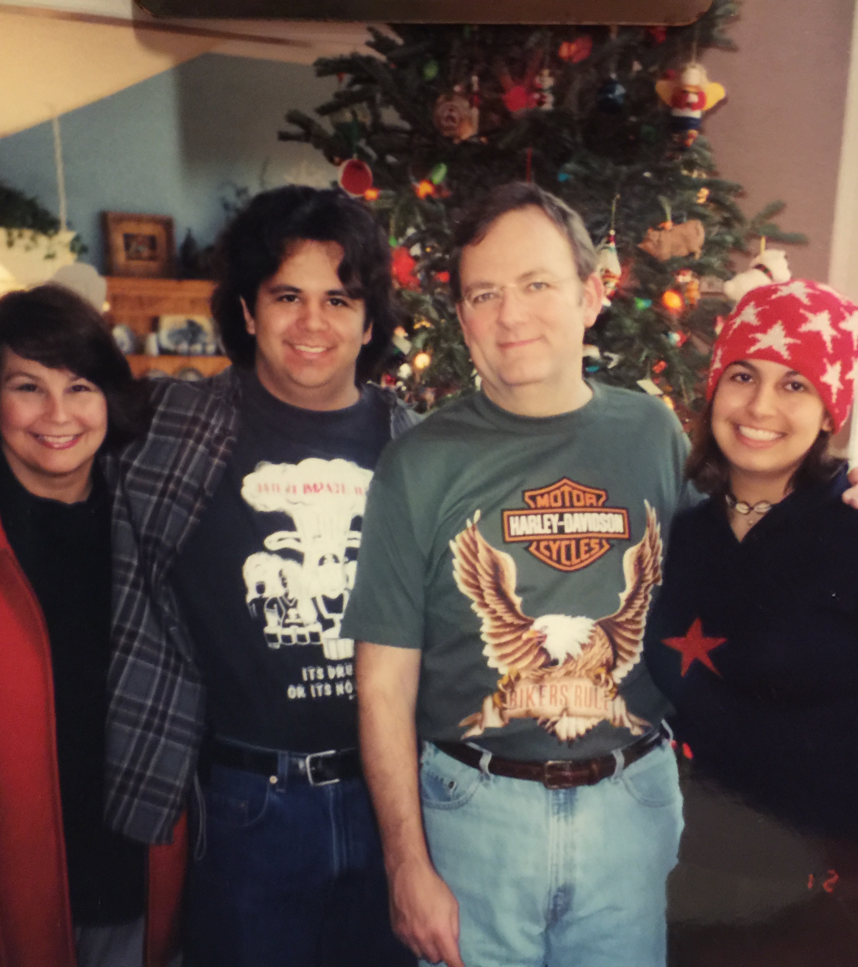
ᏓᏆᏓᏘᎾᎥᎢ / ᏏᏓᏁᎸ ᎠᏆᏤᎵᎢ dagwadatina’v’i / sidanelv agwatseli’i
Hi’a agitsi – Joyce Frey dudo’a.
Hi’a ayv!
Hi’a agidoda – James Frey dudo’a.
Hi’a agidohi – Hannah Frey dudo’v’i.

Slide 5
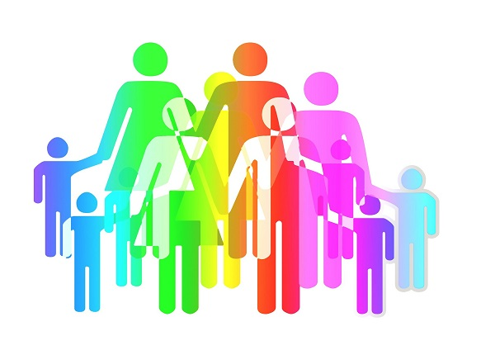
Family terms = relatedness
“agitsi” – 3rd person singular > 1st person singular
“oginali’i” – 1st person dual exclusive (set B)
“ostatlinvtsi” – 1st person dual exclusive (set A)

Slide 6

Tutorial
Work together to complete the section on family and family terms
Practice reading through the dialogue – 1 person will be “Bill” and one will be “John” (then switch) Feel free to alter names or use your own

