Slide 1
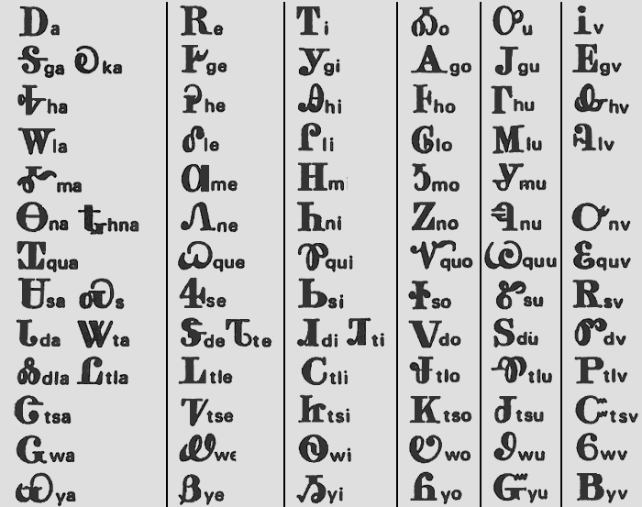
Cherokee Syllabary – How it works
Cross-referenceable
a e i o u v
G/K Ꭶ
H
L
M Ꮌ
…

Slide 2
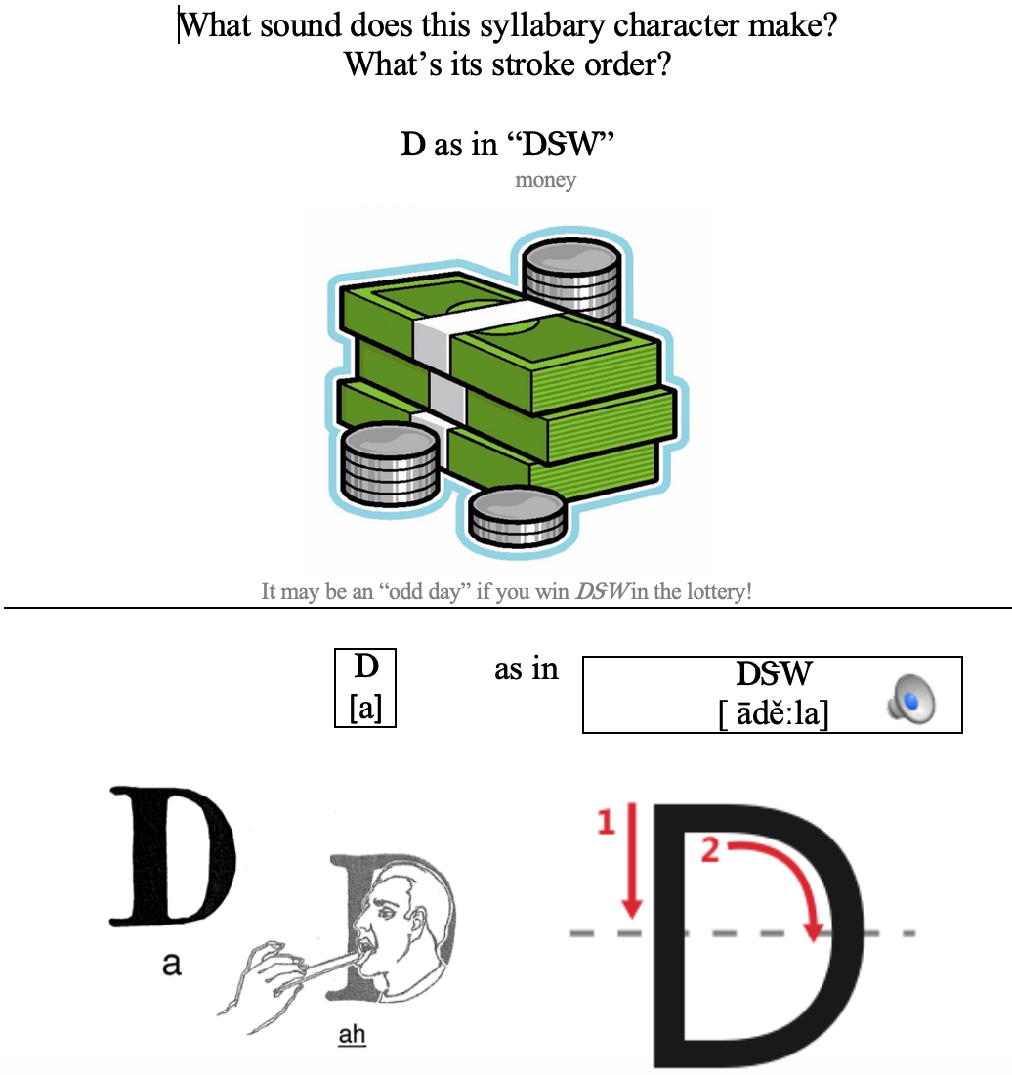
Learning Syllabary
Mnemonic devices are your friend
Test yourself lots of different ways (see Wyner’s Fluent Forever)
Learn whole words, names – then you’ll know lots of characters at once! (ᏣᎳᎩ, ᏏᏲ, ᎣᏏᏉᏧ...)

Slide 3
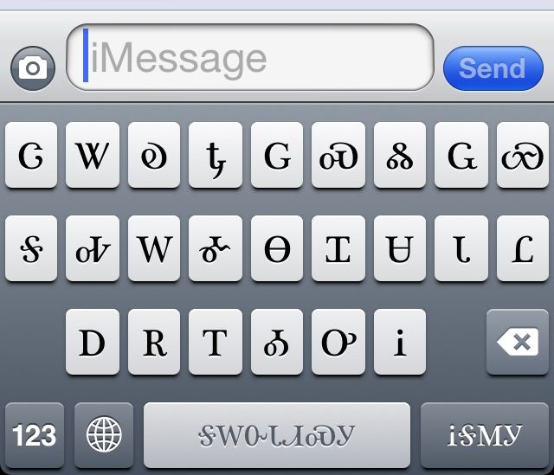
Syllabary on Devices
Cherokee QWERTY or other phonetics-based keyboard (?)
  Use caps lock to type in phonetics ➔ syllabary
  Sx ➔ Ꮝ, ra ➔ Ꮭ, qa ➔ Ꮖ
  Za ➔ Ꮳ, hb ➔ Ꮏ
Texting – type Ꮳ (tsa) and Ꭱ (e) and the Ꮴ (tse) character appears

Slide 4
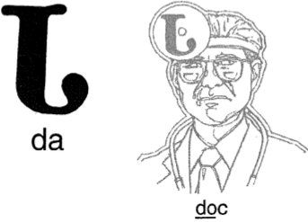
Syllabary Quizzes
For your first quiz, you will be responsible for:
Ꭰ, Ꭳ, Ꮟ, Ᏺ, Ꭺ, Ꮙ, Ꮖ,
Ꮣ, Ꮩ, Ꮃ, Ꮥ, Ꮕ, Ꮳ, Ꮷ

